Slide 1

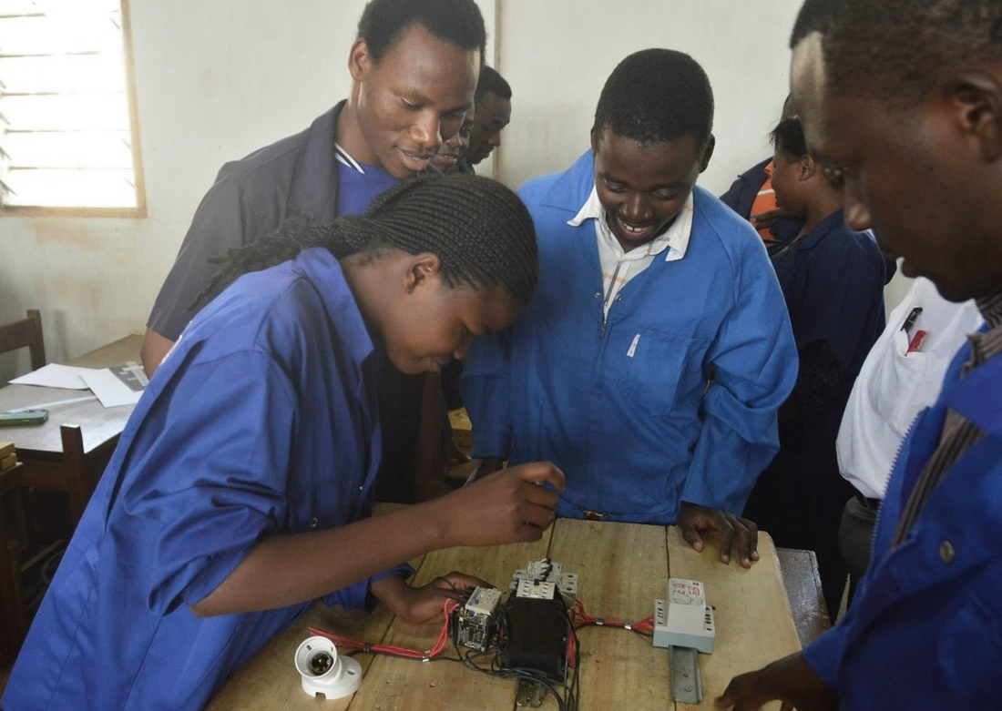

Blended Learning for TVET
Professor Asha Kanwar
With inputs from Dr Sanjaya Mishra, COL
24 March 2025

Slide 2
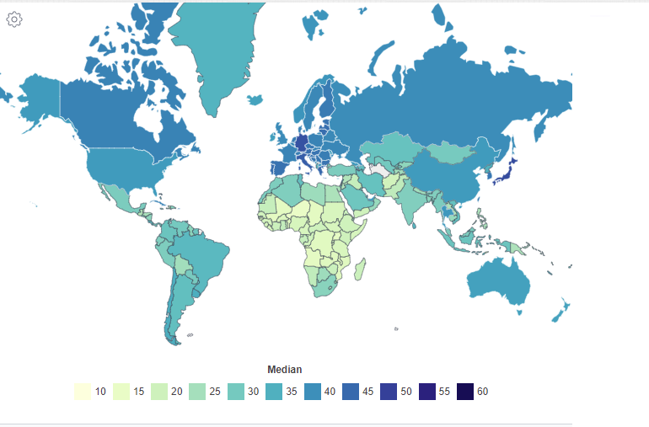
World Median Age by Country - 2020
Source: https://worldpopulationreview.com/country-rankings/median-age ,Retrieved on 20 November 2023

Slide 3


Key Issues for Youth
Decline of 92 million jobs but 170 million new jobs may emerge
Skills required for the emerging green and blue economies
6 in 10 workers will require training before 2030
3 million more jobs in education including TechVoc Teachers
Source: The Future of Jobs Report 2025, WEF

Slide 4

Future of Jobs 2025-2030
On demand jobs:
AI,IT, renewable energy health related jobs
Declining jobs:
Banking, postal services and data entry type jobs
Skills needed: resilience; flexibility; creativity; leadership; social influence
Source: https://www.weforum.org/reports/the-future-of-jobs-report-2025/

Slide 5


4.4
Increase the number of youth and adults who have relevant skills including technical and vocational skills for employment, decent jobs and entrepreneurship.

Slide 6

Rwanda Vision 2050
Technology and Innovation skills
Manufacturing & Industrial skills
Agribusinesses and food security
Renewable Energy and Green skills
Construction and Urban Planning

Slide 7
Context: labour market has:
‘imbalances between skills demand and supply’
‘mismatches between employer expectations and graduate supply’
‘growing youth unemployment’
Rwanda Annual State of Skills Supply and Demand (August 2022) ix

Slide 8

DISTANCE EDUCATION
=
Separation of
teacher and learner
Notes:
UKOU started as a mean to provide second chance education to the working class, those who missed out quality higher education.

Slide 9
OPEN LEARNING
= fewer barriers
and is NOT the same as
DISTANCE EDUCATION
BUT, they are complementary
Therefore: ODL

Slide 10
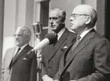

“
Open as to people,
Open as to places,
Open as to methods, and, finally,
Open as to ideas
Lord Crowther
Foundation Chancellor of the The Open University, 1969
Notes:
UKOU started as a mean to provide second chance education to the working class, those who missed out quality higher education.

Slide 11

‘Open-ness’ in Practice
Open admission
(no entry qualifications)
Multiple open channels
(radio, TV, etc.)
Open curriculum
Open access (Anytime, anywhere)
Open participation
Open accreditation
(Wedemeyer, 1973)

Slide 12

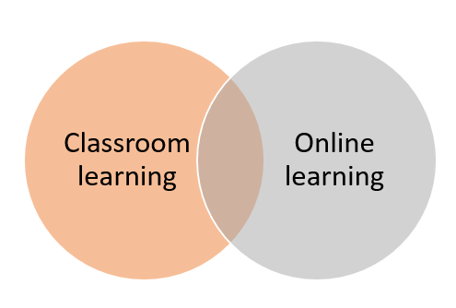

Hybrid learning
Blended learning
E-learning

Slide 13
Terminologies used
Independent learning
Open learning
Flexible learning
Distance learning
Online learning
United State of America
India, United Kingdom
Australia, New Zealand
More widely used
New age DE

Slide 14

Blended learning

Slide 15
Blended Skills Training?
Face-to-Face Courses
Blended Courses
Distance/Online Courses
MOOC
Mobile learning
ICT integration in teaching and learning
Open and Distance Learning

Slide 16
Challenges
Lack of acceptance of online mode of training
Lack of readiness and capacity to transition
Lack of quality training content

Slide 17
Blended Learning is
the thoughtful fusion of face-to-face and online learning experiences
Source: Garrison, D., & Vaughan, N. (2008). Blended learning in higher education. San Francisco, CA: Jossey-Bass.

Slide 18

What is being blended?
Combining instructional modalities (or delivery media)
Combining instructional methods
Combining online and face-to-face instruction

Slide 19
Levels of Blending
Activity-Level
Course-Level
Programme-Level
Institutional-Level
Notes:
Activity-Level Blending. Blending at the activity level occurs when a learning activity contains both face-to-face and CM elements
Course-Level Blending. Course-level blending is one of the most common ways to blend. It entails a combination of distinct face-to-face and CM activities used as part of a course.
Program-Level Blending. observe that blends in higher education are often occurring at the degree program level.
Institutional-Level Blending. Some institutions have made an organizational commitment to blending face-to-face and CM instruction.

Slide 20
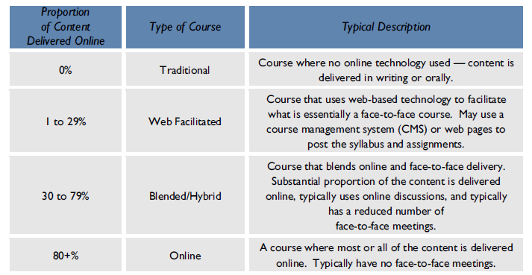
How much of blending?
Source: Allen, & Seaman (2014). Grade Change: Tracking Online Education in the United States, Babson Survey Research Group and Quahog Research Group. Retrieved from https://www.onlinelearningsurvey.com/reports/gradechange.pdf

Slide 21
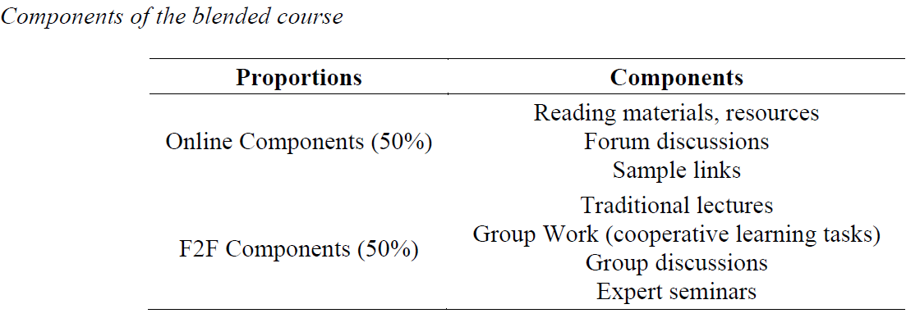
Example
Source: Gedik, N., Kiraz, E., & Ozden, M. Y. (2013). Design of a blended learning environment: Considerations and implementation issues. Australasian Journal of Educational Technology. 29(1), 1-19

Slide 22
Blended Learning is…
BL= F2F+LMS
Source: Fadde, & Vu (2014). Blended Online Learning: Benefits, Challenges and Misconceptions, In Patrick R. Lowenthal, Cindy S. York, and Jennifer C. Richardson, Eds. Online Learning: Common Misconceptions, Benefits and Challenges (p.33-48). New York: Nova Science Publishers

Slide 23
Why blended learning?
Broaden the spaces and opportunities available for learning;
Support course management activities (e.g., communication, assessment submission, marking and feedback);
Support the provision of information and resources to students;
Engage and motivate students through interactivity and collaboration.
Source: Bath, D., & Bourke, J. (2010). Getting Started with Blended Learning. Mt Gravatt: GIHE

Slide 24
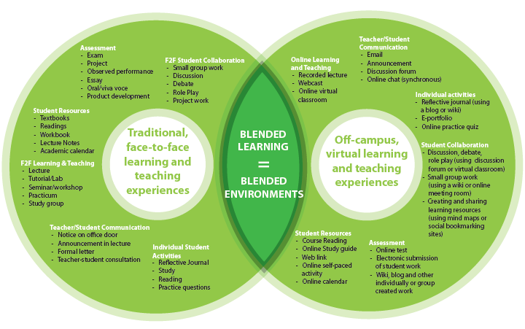
Blended Learning Environment
Source: Bath, D., & Bourke, J. (2010). Getting Started with Blended Learning. Mt Gravatt: GIHE

Slide 25




Taxonomy of Blended Learning
BLENDED LEARNING
Rotation model
Flex model
Self-blend model
Enriched-virtual model
Station-rotation model
Lab-rotation model
Flipped classroom model
Individual rotation model
Notes:
Rotation model – a program in which within a given course or subject (e.g., math), students rotate on a fixed schedule or at the teacher’s discretion between learning modalities, at least one of which is online learning.
Flex model – a program in which content and instruction are delivered primarily by the Internet, students move on an individually customized, fluid schedule among learning modalities, and the teacher-of-record is on-site.
Self-Blend model – describes a scenario in which students choose to take one or more courses entirely online to supplement their traditional courses and the teacher-of-record is the online teacher.
Enriched-Virtual model – a whole-school experience in which within each course (e.g., math), students divide their time between attending a brick-and-mortar campus and learning remotely using online delivery of content and instruction.

Slide 26
Rotation Models
Rotation Model—rotate b/w diff learning modalities, online learning, hands-on workshops, classroom instruction
self paced elearning modules and instructor led sessions
Eg Welding program—students learn safety protocols online, practice welding techniques in a lab, receive feedback from instructors in person

Slide 27
Flex Model
Majority of learning delivered online
Face to face support provided as needed
Students control pace and timing of their learning
Online corses for theoretical knowledge and optional in personsessions for practical trg
Example: students complete online modules on engine mechanics in an automotive repair program
Attend in person sessions for hands on repairs

Slide 28
Self-Blend
Students supplement their traditional classroom learning with online courses or resources outside school hours
Access to recorded lectures, virtual labs or industry specific software for self-paced learning
Example: culinary arts program—students attend in person cooking classes; Use online resources to learn advanced techniques or international cuisines

Slide 29
Enriched Virtual Model
Complete majority of courses online
Attend face to face classes for handson trg, assessments or collaborative projects
Use VR or AR tools for simulating real world scenarios
Complemented with on site trg
Example: construction program where students learn building codes and design principles online
Attend in person sessions for hands on trg

Slide 30

Benefits
Flexibility
Accessibility
Practicality
Industry relevance

Slide 31

Blended Learning Model at the KSTVET
Term 1
On campus, face-to-face training for all trainees
(3 months)
Term 2
Off campus, virtual training for all trainees
(3 months)
Term 3
On campus, face-to-face training for all trainees
(3 months)
Term 4
Teaching practice at workplaces for all trainees
(3 months)
Technology integration
( LMS, Video conferencing, OER Repository & print materials)
Technology integration
( LMS, Video conferencing, OER Repository & print materials)
Technology integration
( LMS, Video conferencing, OER Repository & print materials)
Foundational
Knowledge and skills on TVET
Basic skills for blended TVET
Theories, models and comparative studies on TVET
Methodologies and technologies for blended TVET
Practice and application of multiple skill sets for blended TVET in safe environment
On-the-job training, coaching and mentoring in face-to-face/ hybrid/ blended workplaces

Slide 32

Institutional success factors
Aligned to organisational needs rather than using a generic approach
Organisational readiness, sufficient technical resources, motivated faculty
Freedom to adopt different models of blended learning
Blended learning should be introduced as a scholarly and transformative redesign process
Carrying out regular evaluations and sharing the results
Source: Stacey, E. & Gerbic, P. (2008). Success factors for blended learning. In Hello! Where are you in the landscape of educational technology? Proceedings ascilite Melbourne 2008. Retrieved from http://www.ascilite.org.au/conferences/melbourne08/procs/stacey.pdf

Slide 33

Teachers
Continuing professional development for teachers with sufficient time for development
Ongoing pedagogical and technical support
Dealing with teachers’ fears of loss of control, and general uneasiness about the impact of online learning on classroom
The impact on teachers’ workloads must be taken into account
Use creation of shareable and reusable digital resources in an effort to ensure that blended learning is sustainable
Source: Stacey, E. & Gerbic, P. (2008). Success factors for blended learning. In Hello! Where are you in the landscape of educational technology? Proceedings ascilite Melbourne 2008. Retrieved from http://www.ascilite.org.au/conferences/melbourne08/procs/stacey.pdf

Slide 34
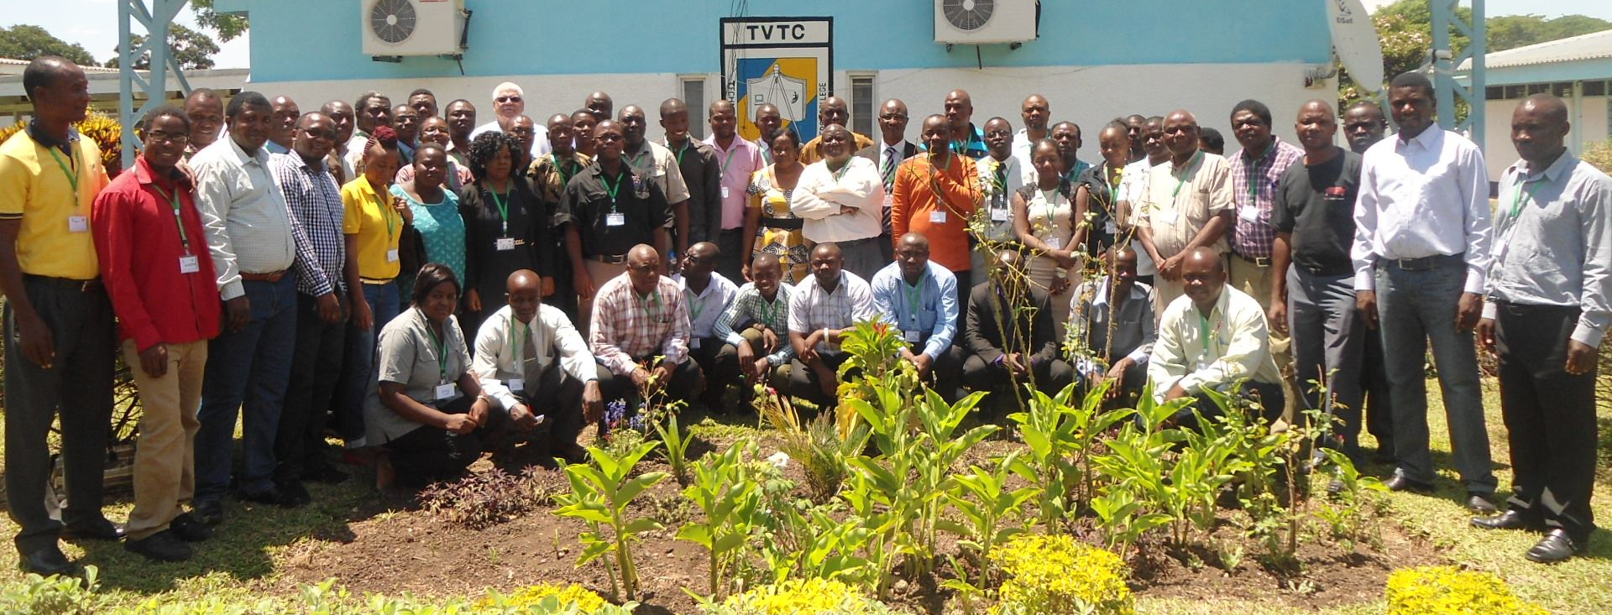
Zambia TVET teacher training
Ministry of Higher Education request in response to COVID 19
Mentors, online facilitators, TVET teachers
On the job training
Online OER available
Notes:
In response to COVID 19, Zambian’sMoHE approached COL to support them to train TVET teachers in online learning. COL has been partnering with Zambia’s Technical and Vocational Teachers College for ten years to build their capability in distance and online learning. TVTC has its own learning management system and trained staff.
With COL’s support, three of the capable people are presently training one person from each of the 28 public TVET institutes in how to facilitate online. In a few weeks, once these 28 have been trained, the existing experts will mentor the 28 facilitators to apply their leanring as they each teach 30 TVET teachers using COL’s Flexible Skills Development course. 840 TVET teachers will be quickly trained, and Zambia will have 28 new trainers who can independently train many more TVET teachers. Both the Facilitating Online Courses course and the Flexible Skills Development course are COL OER which COL has been using to train others across the Commonwealth, and could be easily sent to TVTC and installed in their learning management system ready to go.

Slide 35
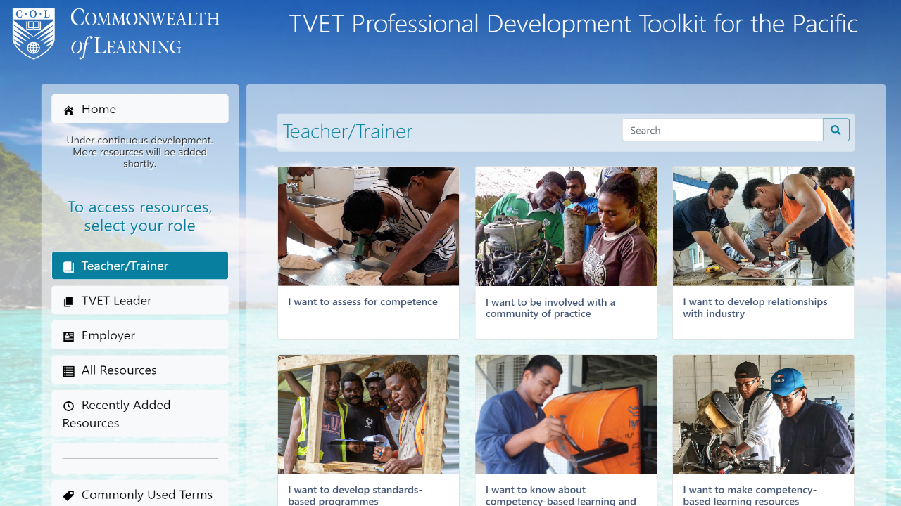

Slide 36

Students
Students’ readiness for blending learning
Increased self-regulation in learning and time management skills
Consistent and transparent communication around the new expectations to use technology in teaching and learning
Clarity on assessment
Source: Stacey, E. & Gerbic, P. (2008). Success factors for blended learning. In Hello! Where are you in the landscape of educational technology? Proceedings ascilite Melbourne 2008. Retrieved from http://www.ascilite.org.au/conferences/melbourne08/procs/stacey.pdf

Slide 37

Pedagogic Considerations
Combination of the virtual and physical environments should be made on the basis of subject need and learning outcomes
Utilise the strengths of the different media and add value to the learning activities
The central role of the face-to-face environment along with activities for before, during and after class needs to be designed
Make the blend relevant to the learners need
Source: Stacey, E. & Gerbic, P. (2008). Success factors for blended learning. In Hello! Where are you in the landscape of educational technology? Proceedings ascilite Melbourne 2008.
http://www.ascilite.org.au/conferences/melbourne08/procs/stacey.pdf
Teaching by Nick Youngson CC BY-SA 3.0 Alpha Stock Images

Slide 38
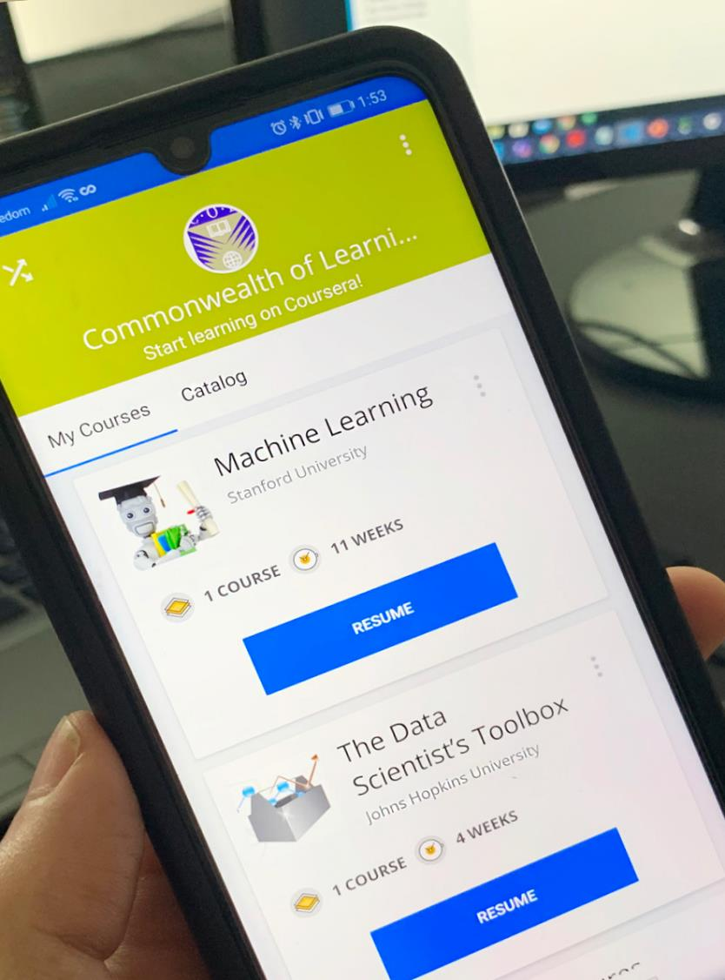



Skilling and re-skilling
Learning to learn online
Providing just-in-time training for livelihoods
Learner support essential
Notes:
# taken from Shadrach presentation at PUM April 2023. Enrolments since July 2021 for all three platforms.

Slide 39
Getting the Blend Right
Independence
Interaction

Slide 40
A course is a course…
The strongest predictor of success is in previous academic performance (Dziuban, 2011). Historically, students who have done well in courses do well in any mode; a course is a course.
Source: Dziuban, C., & Moskal, P. (2011). A course is a course is a course: Factor invariance in student evaluation of online, blended and face-to-face learning environments, Internet and Higher Education, 14, 236–241
Notes:
.

Slide 41
Requirements

Slide 42

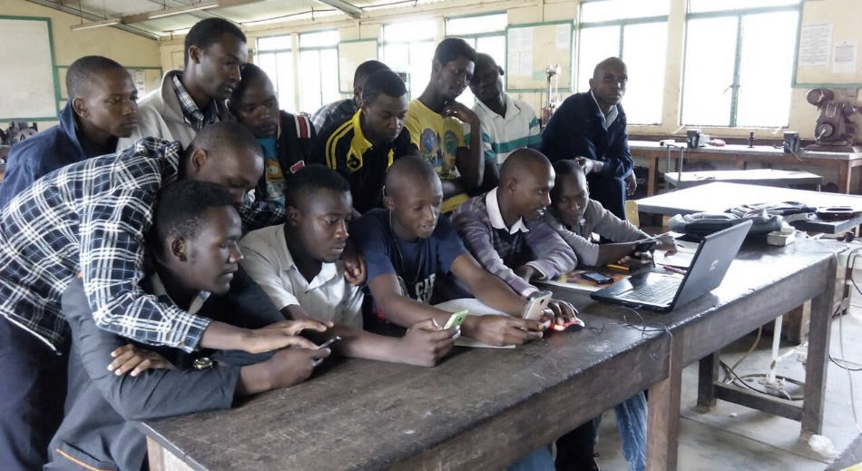
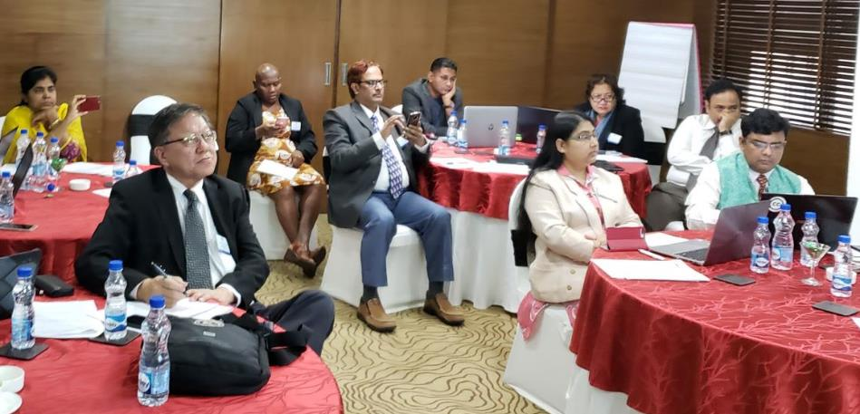

Connectivity
Content
Capacity
Credentials

Slide 43
Increasing access to broadband
Access to devices
Zero rating of educational platforms
1. Connectivity

Slide 44

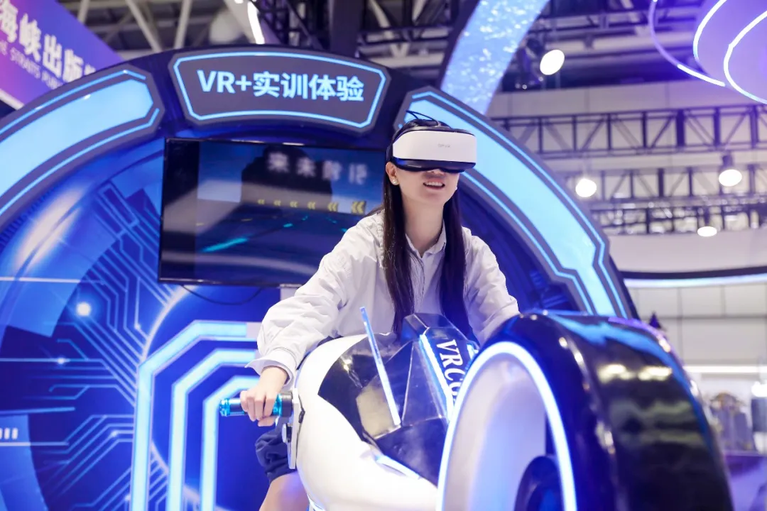
Fuzhou Software Technology Vocational College
The VR motorcycle racing by NetDragon
One of the VR training devices created under NetDragon's "Vocational Education Going Global" initiative.
Set up digital human live streaming production courses based on market demand. Students participate in the operation of “Xueyu Renyun” on the Tik Tok

Slide 45
Metaverse for Skilling and Re-skilling
ImmerseMe: connects students with virtual internships and job shadowing opportunities across industries
Osso VR: hands-on surgical training simulations
Google Expeditions: virtual field trips to museums and historical sites (free App)

Slide 46
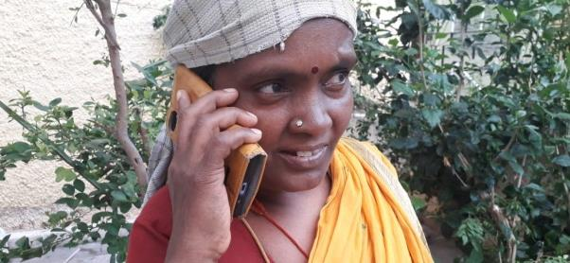
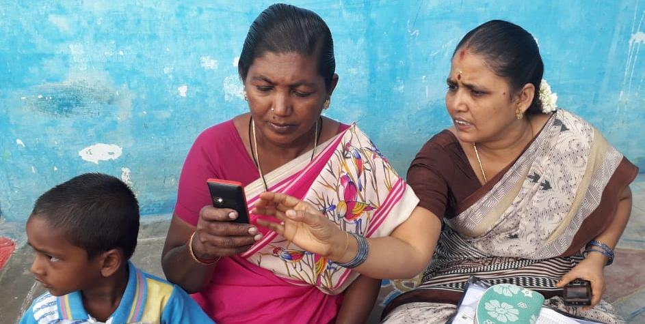
REACHING THE UNREACHED
Mobile MOOC technology - connect farmers with basic (non-smart) phones to access online learning
https://mobi.mookit.co/
Notes:
MobiMOOCs - Land Preparation and Soil Fertility
Total registration: 1942
Total completion: 540
Mobi MOOCs use voice connections to deliver educational content where bandwidth is low and data connections are expensive
When a user calls up a number (can be toll-free), an Interactive Voice Response System takes over and guides the user through learning objects

Slide 47
Multiple media
Simulations, Augmented and Virtual Reality
Artificial Intelligence
2. Content

Slide 48

Good Practice: OER
Open education and OER to promote connected learning.
Harness the potential of OER and MOOCs for quality adult education, schooling and VET

Slide 49
SkillsCommons: A free and open online library containing learning materials and program support materials for job-driven workforce development.
OER Africa - TVET Resources: Open-access TVET materials, including practical and simulation-based learning content.
UNESCO-UNEVOC TVET Learning Resources: A global repository of TVET-focused educational materials, including practical guides and e-learning resource
LabXchange: A free platform with virtual labs and simulations, great for vocational education in science, healthcare, and engineering.
These resources offer a variety of teaching materials, including full courses, modules, syllabi, lectures, assignments, quizzes, activities, games, simulations, and tools to create these components.

Slide 50
Building capacities of policy-makers
Developing capacity of teachers for blended learning
Preparing learners for self-directed lifelong learning
3. Capacity

Slide 51

Good Practice: Community engagement
Community based telecentres
Government funding of NGOs working in communities
National Programme for soft skills training for youth (15 -17)

Slide 52
Recognition of qualifications
Accreditation of prior learning
Flexible pathways for learning
Mobility of people
and learning across
the planet
4. Credentials

Slide 53

Good Practice: AQF & Recognition of Prior Learning
The AQF a national framework for formal and vocational education and training
Supports credit transfer and Recognition of Prior Learning
Structured and flexible system to promote lifelong learning

Slide 54

TVET institutions are:
Interacting with industry to develop relevant courses for employability
Addressing skill gaps with just-in-time training
Offering micro-credentials
Using appropriate ICT tools for virtual/blended training
Source: https://www.bcg.com/en-ca/publications/2023/ten-lessons-for-universities-prepare-students-future-of-work

Slide 55






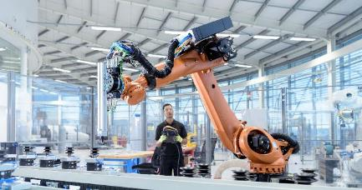
Effective blended learning in TVET
Strong Infrastructure & digital access: Kenya; Rwanda
Engage employers and industry: SA: Vulindlela Academy
Teacher and Trainer capacity building
Context specific content: Zanzibar TVET elearning content adapted for local tourism industry
Government commitment: Namibia Virtual TVET model
Notes:
Practical Learning with Simulations & VR: allow students to practice skills in a risk-free environment (e.g., welding, automotive repair, healthcare procedures); reduces material costs
Flexible Learning : review digital lessons (videos, step-by-step guides) before hands-on practice.
Enhanced Industry Collaboration: integrate industry-relevant content; virtual apprenticeships and remote mentoring expand access to expert guidance.
Cost-Effective & Scalable Training: physical workshops complemented with virtual labs.
Continuous Assessment & Feedback: track progress through Learning Management Systems (LMS) ; offer personalized support ; instant feedback.
Recognition of Prior Learning (RPL): assessment of prior knowledge through digital portfolios and online tests; supports upskilling for working professionals.

Slide 56
Success Stories
Ghana Skills Development Initiative: by 2024, 10,000 apprentices completed training with notable increase in females due to flexibility
Kenya Ajira Digital Program: By 2023 >300,000 Kenyan youth trained and securing freelance positions on platforms like Upwork, Fiverr—use mobile technologies and local training hubs

Slide 57
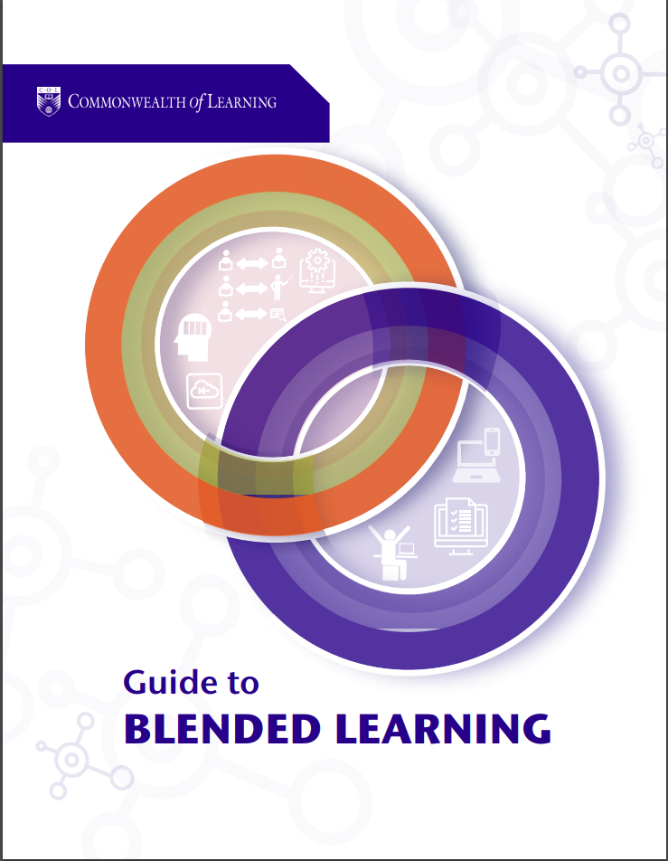
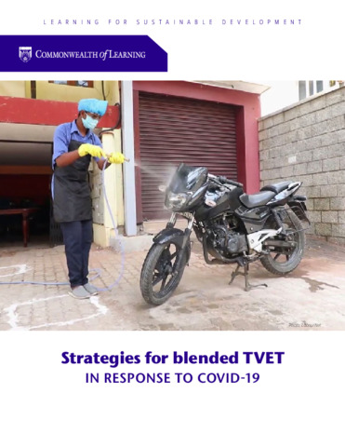
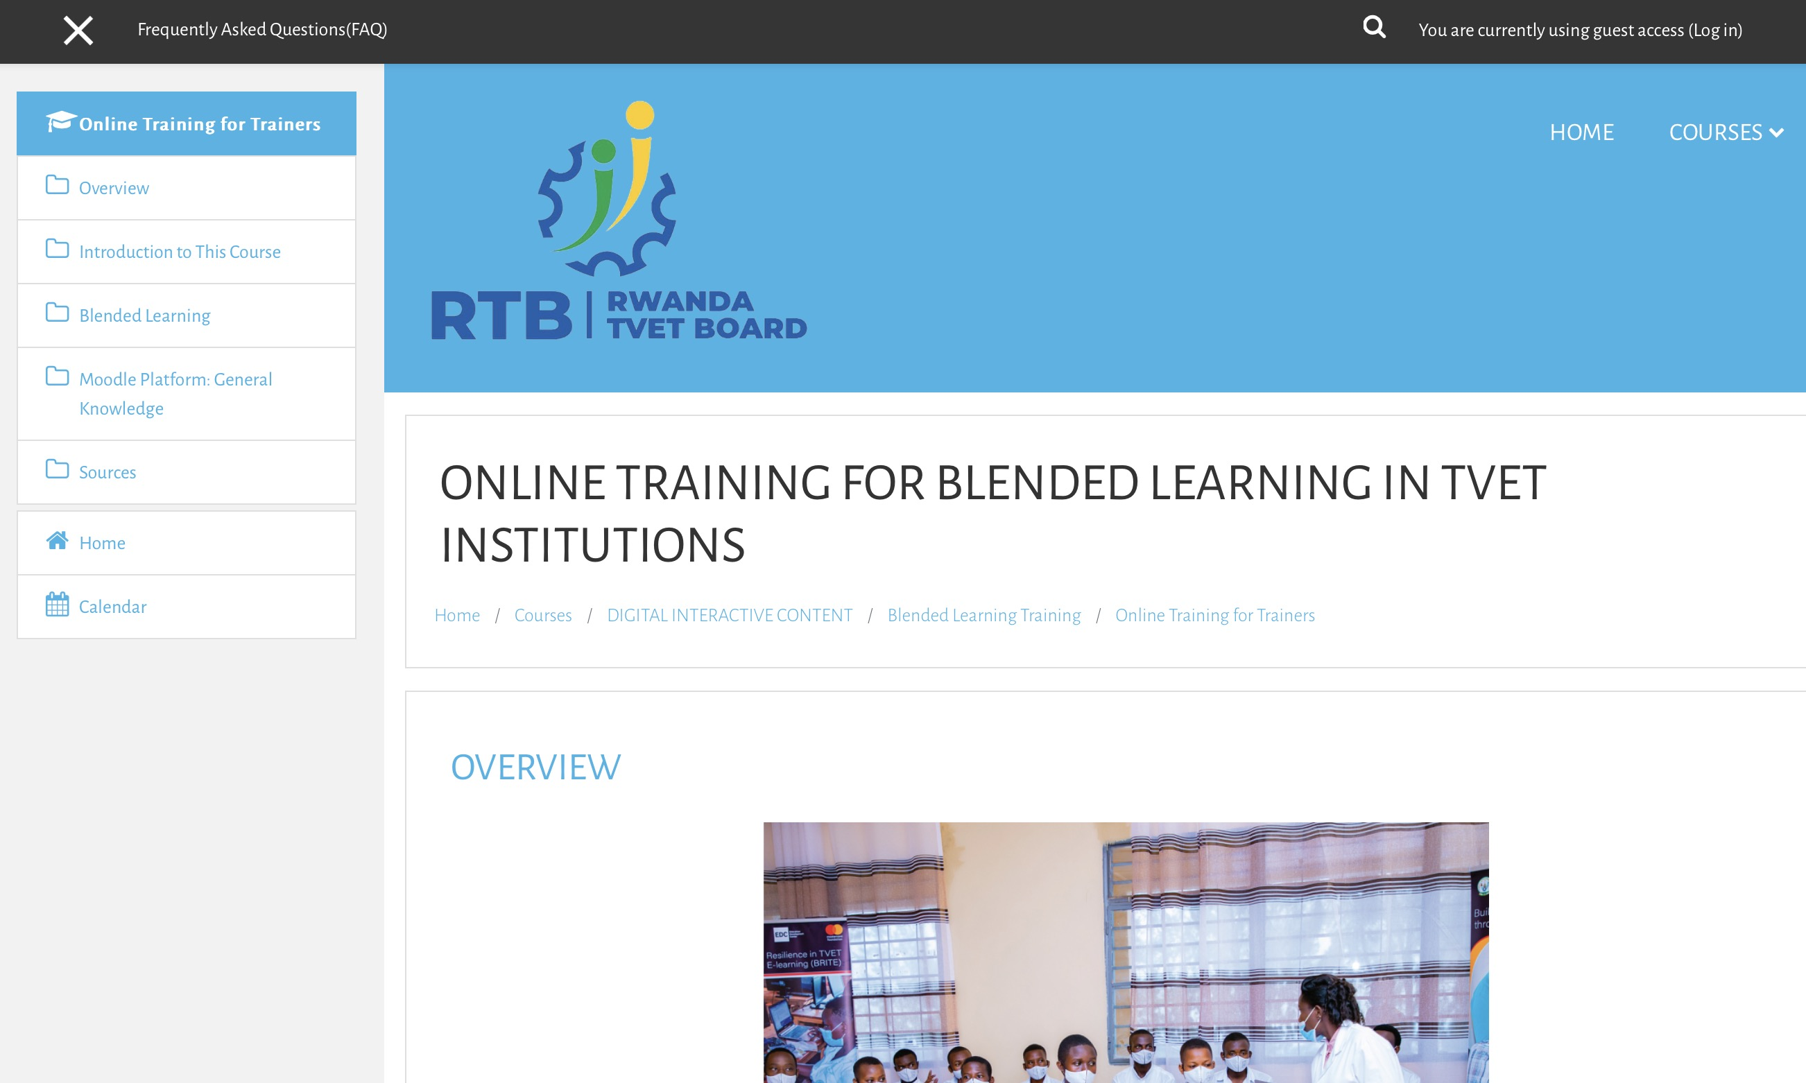
Resources
Guide to Blended Learning (COL 2018) Blended Learning Design Template
Strategies for blended TVET IN RESPONSE TO COVID-19 (2020)
Online Training for Blended Learning in TVET Institutions: RTB

Slide 58
Thank You

