Slide 1

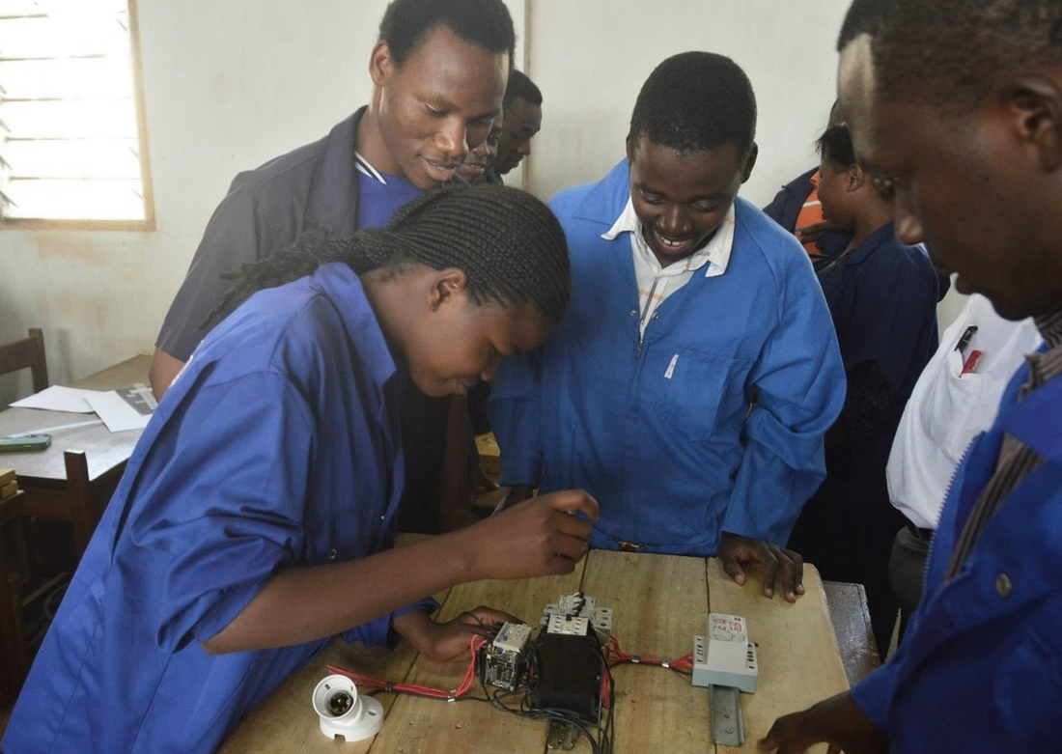

Role of Learner Support
Professor Asha Kanwar
27 March 2025

Slide 2
Outline
Role of Learner Support in Blended Learning
What is Learner Support?
Academic Support and Non-Academic Support
Motivating Learners

Slide 3
Role of Learner Support

Slide 4

Distance Education
separation of teacher and learner in the learning process;
influence of an educational organization in the planning, designing and delivering of learning resources and opportunities;
use of technical media for delivery of learning content;
provision of two-way communication between student and teacher, and student and students;
absence of regular learning groups.
Source: Keegan, 1996.

Slide 5

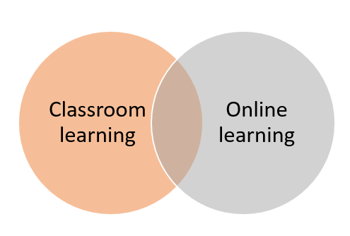

Hybrid learning
Blended learning
E-learning

Slide 6
High Dropout Rates
US: 20-50%
UK: 20-44%
Australia: 35-55%
African countries: 50%
Maxwell CC Musingafi et al, 2015. ‘Challenges for ODL Students: Experiences from Students of Zimbabwe Open University. Journal of Education and Practice Vol 6. No 18

Slide 7
Dropout rates in online learning
Fully online non-completion rates 10-15% higher than hybrid/f2f contexts (XU & Jaggars, 2011)
Online classes: average dropout rate: 30%
MOOCs: completion rate 5% (Koller, 2013) 15% (Jordan, 2015)

Slide 8
What are the reasons?
Lack of motivation (Bonk, 2002)
Time conflicts (Hiltz & Goldman, 2005)
Lack of interaction/ support (Carr, 2000)
Sense of isolation and technological difficulties (Xu & Jaggars, 2011)

Slide 9
Reasons
Internal: related to education
External: related to non-academic aspects, finance, time et
Students’ characteristics: motivation
Student skills—digital literacy, time management etc
A B Yilmaz & S Karatas, 2022. ‘Why do open and distance education students drop out? Views from various stakeholders’ International Journal of Ed Tech in HE, 19, Article No 28.

Slide 10
COL Examples
Elearning for International Organisations: 85-90% success rate: One on One Tutoring
COL-Coursera Workforce Recovery: 45% completion rates: Help Desks

Slide 11
What is Learner Support?

Slide 12
Learner Support is key to Student Success
Student
Learning materials
Learner Support
=
SUCCESS
Notes:
Retrieval of dropouts and at-risk students important for learner support

Slide 13
Who are our Learners?
Adult learners: average age varies
Different goals and motivations
Diverse cultural and economic backgrounds
Gender differences
Persons with Disabilities
Prior knowledge, skills and experience

Slide 14
What do distance learners need?
Info about the institution and the system
Access to tutors to overcome learning problems and maintain motivation
Advice on how to study
Need to be part of a larger body of learners rather than isolated

Slide 15
Learner Support
Academic support
Non-academic support
Explaining
Assessing
Chasing progress
Developing skills
Advising
Counselling
Administration
Inspiring
Via different media
Photo by Neil Thomas on Unsplash
Source: Adapted from Simpson,2002

Slide 16
Types of Learner Support
Intellectual/academic: Tutoring
Emotional/Organisational : Counselling
Effective operations: Administrative Support
Interaction with other students: Peer Support

Slide 17
Skills Required by Staff
Warmth and genuineness
Empathy
Listening skills
Explicatory skills to explain content and advise on time management
Digital skills

Slide 18
Empathy
Ethics
Equity

Slide 19
Academic & Non-Academic Support

Slide 20
Learners Support: three stages
Pre-entry
During the course
End of course
Choice of courses
Preparing for learning
Financial support
Navigating and using technologies
Timely information
Academic support
Feedback on assignments
Administrative and technical issues
Results
Verification and supply of transcripts
Accreditation issues
Placement services
Practical and internship
Alumni and social groups
Communication
Library services
Photo by Priscilla Du Preez on Unsplash
Photo by Pang Yuhao on Unsplash

Slide 21
Academic
Careful Design
Responding to difficulties
Ongoing feedback
Collaborative learning activities with other students

Slide 22
Learner Support over the years
External Degrees: curriculum outline; sit in exams
Correspondence courses: course materials; local support
UNISA: could telephone HQs between 9 am to 1 pm
(Alan Tait, 2003)

Slide 23
Three-tier model of Learner Support
HQ
Regional Centres
Study Centres
Admission and examination
Material supply
Clarification on content
Supporting counsellors
Admission and examination
Material supply
Supporting study centres
Providing library support
Organising face-to-face counselling
Library and lab facilities

Slide 24
Models must consider
Learner at the centre
Expert advice and support
Integrate learner support into learner design by embedding videos, video conferencing, podcasts, assessment (Tait, 2014)

Slide 25

How can we support learners?
Provide
  Quality education
  Equitable opportunities
  Empathy
Photo by Wes Hicks on Unsplash

Slide 26
What would RP Need?
Robust ICT Infrastructure
Staff Training
High Quality Educational Resources
Learner Support System
Partnerships with existing institutions/organisations

Slide 27
Culture of Care

Slide 28
Media and Technology for Learner Support
Printed text/guides
Telephone
Radio
Television
SMS
Chat
Online services
Social media

Slide 29
Open University UK: place to virtual space
Regional and Study Centres
Residential Summer Schools for a Week
Individual & Personal Support with a Tutor
Evolved to Call Centres and Customer Service Advisors
Nationally Based student support teams to provide subject expertise by phone/email
Tutor for each module based locally and can provide f2f meetings (Tait, 2003, 2014)

Slide 30
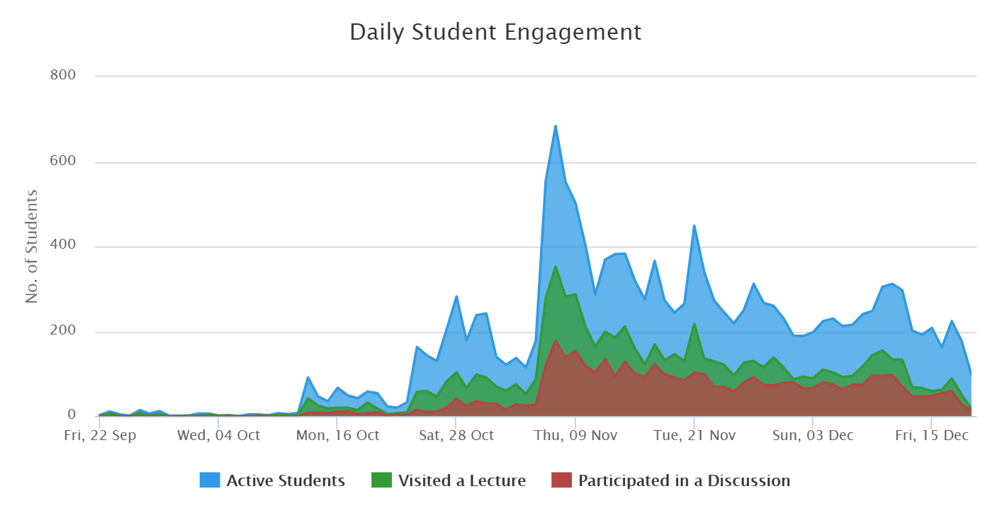
Harnessing ICTs: Learning Analytics
Identify at-risk learners
Provide personal guidance and support
Identify and address difficulties
Promote learning outcomes
Notes:
Using learning analytics in our teaching and learning scenario will empower the teachers to provide personalized support and guidance to the learners. It will identify at risk learners and where they are not performing well. Learning analytics will help strengthen overall learning outcomes by fostering mastery learning.

Slide 31


More personalized: AI in Education
Can provide an intelligent, personal tutor for every learner
Encourage intelligent support for collaborative learning
Adaptive group formation
Expert facilitation
Source: https://www.ibm.com/watson/advantage-reports/ai-social-good-education.html
Notes:
AI already has a presence in education. The number of examples is not large. One of them is the Intelligent Tutoring System or ITS. These systems use AI techniques to simulate one-to-one human tutoring, delivering learning activities best matched to a learner’s cognitive needs. They are able to provide targeted and timely feedback, all without an individual teacher having to be present. With large student numbers working in multiple collaborative groups, it can be impossible for a person to make any sense of the large volume of data that the participants are generating in their discussions. AI, in particular, Machine Learning, can help analyse and summarise the discussions to enable a human tutor to guide the students towards fruitful collaboration.
Ai-powered systems can be deployed as robots that are similar to the ones in popular imagination. They can visualize things and can synthesise their programmed outputs to create human-like speech. According to Anthony Seldon, robots will quite likely play a role in teaching. The role of teachers may be transformed into one of an overseer.
AI-enabled systems are useful in designing a grouping of students all at a similar cognitive level and of similar interests. AI has been used to train systems to recognise when students are having trouble understanding the concepts that they are sharing with each other.

Slide 32
A personal tutor for every learner?
Khanmigo
A conversational chatbot built on AI
Provides personalized one on one tutoring
Provides real time feedback
Provides academic and career guidance
Source: Goel, A. K., & Polepeddi, L. (2016). Jill Watson: A Virtual Teaching Assistant for Online Education. Georgia Institute of Technology
Notes:
A popular example of AI in education is the Virtual Teaching Assistant. During 2014-16, Professor Goyal at the Gerogia Inst of Technology offered an online course in computer science. He designed and deployed a virtual teaching assistant called Jill Watson who became famous globally. This Ai-powered assistant is an example of a chatbot that converses using text. In subsequent offerings of the same course, he and his team refined the chatbot and the new versions were called by different names. Jill Watson conversed with students like a real life TA. So much as that many students thought that Jill Watson was a human.

Slide 33
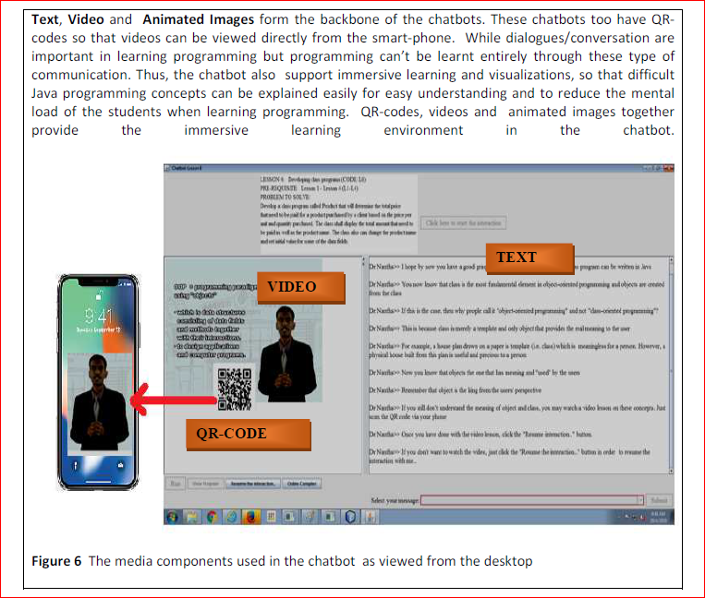
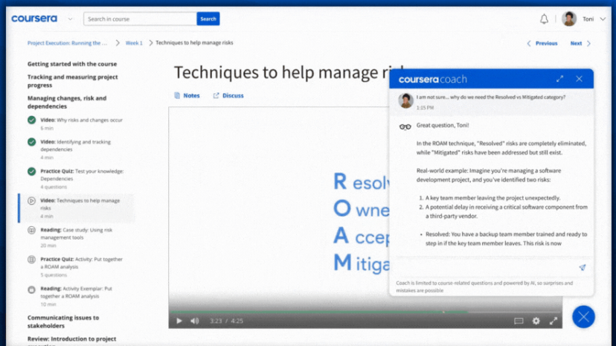
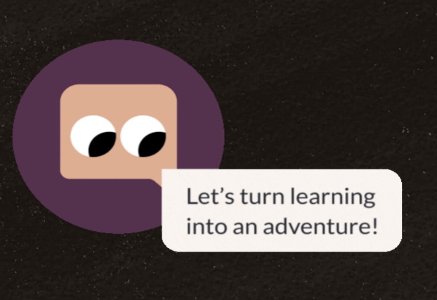
Realizing a 1:1 teacher : student ratio through software
Teaching CS50 with AI
‘Leveraging Generative AI in Computer Science Education’
Rongxin Liu, Carter Zenke, Charlie Liu, Andrew Holmes, Patrick Thornton, and David J. Malan. 2024. Teaching CS50 with AI: Leveraging Generative Artificial Intelligence in Computer Science Education. In Proceedings of the 55th ACM Technical Symposium on Computer Science Education V. 1 (SIGCSE 2024), March 20–23, 2024, Portland, OR, USA. ACM, New York, NY, USA, 7 pages. https://doi.org/10.1145/3626252.3630938
Khanmigo:
Notes:
Our goal was to approximate a 1:1 teacher-to-student ratio through software, thereby equipping students with a pedagogically-minded subject-matter expert by their side at all times, designed to guide students toward solutions rather than offer them outright. The tools were received positively by students, who noted that they felt like they had "a personal tutor.'' Our findings suggest that integrating AI thoughtfully into educational settings enhances the learning experience by providing continuous, customized support and enabling human educators to address more complex pedagogical issues. In this paper, we detail how AI tools have augmented teaching and learning in CS50, specifically in explaining code snippets, improving code style, and accurately responding to curricular and administrative queries on the course's discussion forum.

Slide 34

Gen AI /LLMs in education
Offer a promise in adaptive learning; designing learning paths in a curriculum; learner support
Faculty/Teacher/ Mentor necessary in the loop between Gen AI and the learners
Quality check essential
Eventually, compliance with national regulations an essential requirement

Slide 35


Resource-poor contexts
Kyambogo University, Uganda
Culture of quality = culture of care

Slide 36
A culture of care is an institutional culture that:
Promotes an internal quality system where everyone takes ownership
Values capacity building
Stresses accountability to stakeholders
Focuses on learning

Slide 37
Motivating Learners

Slide 38
Bringing joy to learning: 6 ‘C’s’ Skills
Collaboration
Communication
Content
Critical thinking
Creative Innovation
Confidence
Golinkoff & Hirsh-Pasek, ‘Becoming Brilliant’ cited in Hirsh-Pasek, K., Zosh, J. M., Hadani, H. S., Golinkoff, R. M., Clark, K., Donohue, C., & Wartella, E. (February 2022). ​ Policy brief. Brookings, 2022

Slide 39
Addressing Attrition
Individual: assumptions, skills, background experiences; personal situation
Course-related
Technological

Slide 40
Learner Motivation
Intrinsic : goals; interest, desire to enhance knowledge skills, attitudes; freedom and choice over their actions
Extrinsic: online support; praise from tutors; rewards and recognition; grades, money, certificates

Slide 41

Social Emotional Learning
Social and emotional skills are key
Years after students participated in SEL, their academic performance was an average of 13 percentile points higher than students who didn’t participate.
Source: https://casel.org/fundamentals-of-sel/what-does-the-research-say/, retrieved on 1 June 2023
Notes:
Department of Education (UK) https://files.eric.ed.gov/fulltext/EJ1145076.pdf
Hundreds of studies involving more than 1 million students worldwide across PreK-12 offer consistent evidence that SEL has a positive impact on students’ academic achievement.
SEL interventions that addressed the five core competencies increased students’ academic performance by 11 percentile points, compared to students who did not participate.
The positive impact on academics lasts long-term: Years after students participated in SEL, their academic performance was an average of 13 percentile points higher than students who didn’t participate.
SEL enhances young people’s coping skills, resiliency, and emotion identification, which can help reduce symptoms of depression and anxiety in the short term.
SEL contributes to reductions in bullying and aggression.

Slide 42



Effective Learner Support: From Content to Course
Build interaction.
Encourage discussion.
Practice + Expert feedback necessary.
Notes:
That's why we have coaches in sports and one to one sessions in medicine. But, prior to practice there is need of theoretical knowledge and understanding. Without a theoretical
knowledge, skills development will remain only at the level of craftsmanship.

Slide 43
Interactions: crucial
Learner-content
Learner-teacher
Learner-learner
(Michael Moore, 1989)

Slide 44
Motivating Learners ARCS model
Attention
Relevance
Confidence
Satisfaction
John Keller (1987, 2010)

Slide 45
TEC-VARIETY Model
T: Tone—welcoming environment
E: Encouragement: feedback and support
C: Curiosity: interest in new knowledge
V: Variety: novelty
A: Autonomy: choices and flexibility, sense of purpose
R: Relevance: application to real-life situation
I: Interactivity: at various levels
E: Engagement: with content, tools, involvement
T: Tension—controversies, challenges
Y: Yielding products: videos, podcasts
Khoo & Bonk, Motivating and Supporting Online Learners, 2022

Slide 46
Assessment as learner support
Helpful Feedback
Unhelpful
Rapport
Promote dialogue
Be open to discussion
Suggest ways to improve study techniques
Clear about errors and how to improve
Negative
Discouraging
Careless, inaccurate and not clear
No suggestions for improvement
No follow-up

Slide 47
Service Quality in Learner Support
Systems quality
Materials and teaching quality
Administrative and support quality
Learner satisfaction
Course completion

Slide 48

Ways to monitor
Observe counselling sessions
Monitor the functioning of study centres
Track assignment submission and return
Monitor evaluated assignments
Track material dispatch
Student course experience surveys
Learner dropout data
Notes:
How often we manage data to improve student support? Is lerner support even a matter of concern? How much financial loss do institutions accrue due to poor learner support?

Slide 49

Dimensions of Learner Service Quality
Reliability: e.g., perform counselling sessions without cancellation
Responsiveness: Quick and timely delivery of services
Assurances: Ensuring trust on the systems and practices
Empathy: Personalised services with warmth
Tangibles: Welcoming environment, both in physical and online space, including accessibility

Slide 50
Questions for learner support
Do learners have access to a tutor?
Can learners give feedback to tutors and expect regular communication?
How do you encourage contact and exchange but protect tutors from unmanageable numbers of emails?
How readily do learners have internet access?
At what cost can learners download and print materials distributed digitally?
Are the new technologies familiar or new to them? Do we have mechanisms to support them?

Slide 51
Towards a Model
What will be the learner support system in place at RP?
Do the courses integrate learner support?
Is there a benchmark for providing quality support?
Is the learner support impacting learner success? How do we know?
How do you reach the last mile?

Slide 52
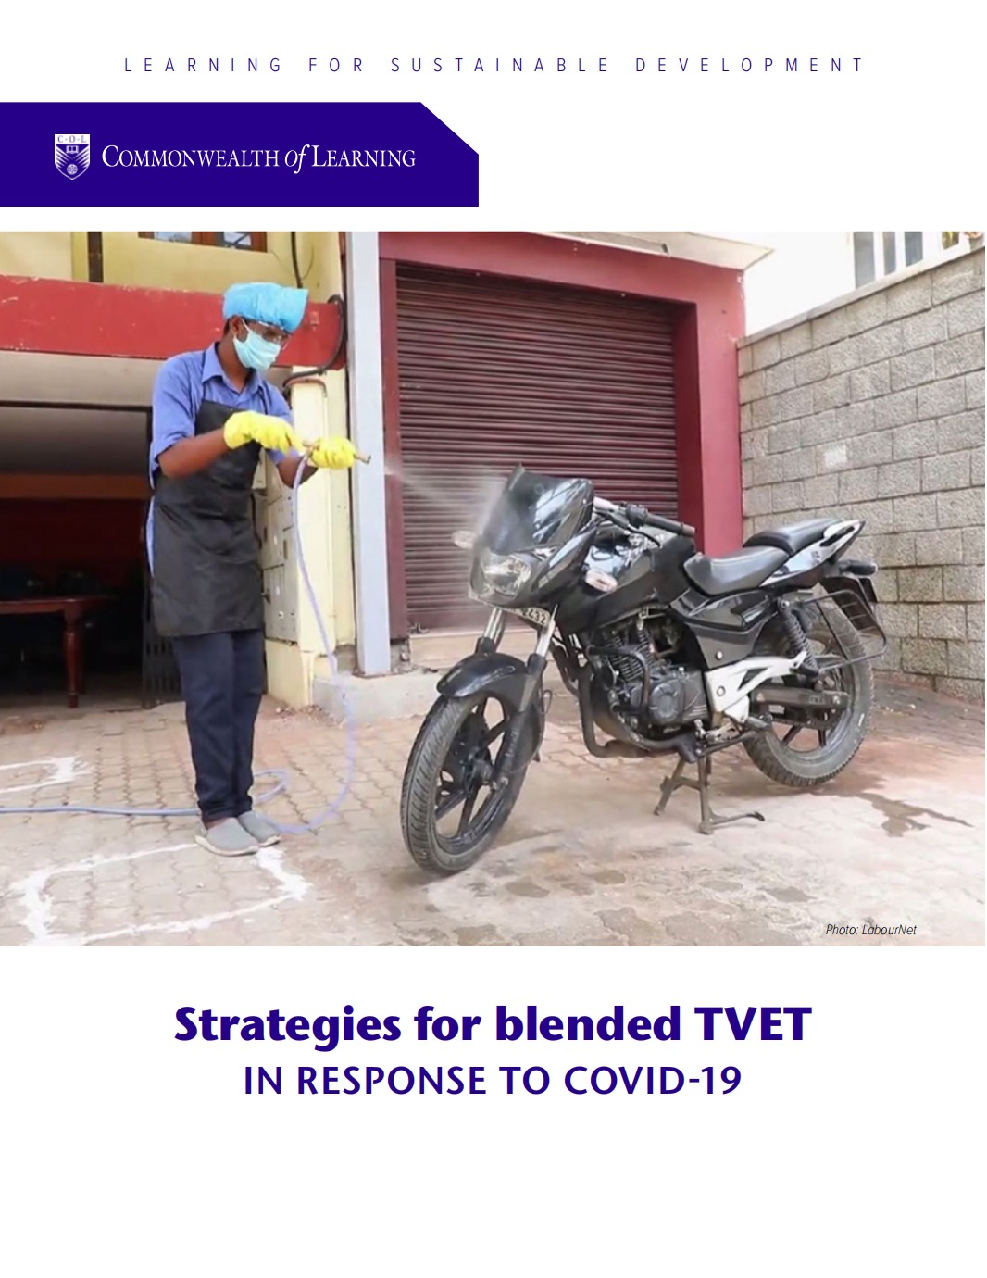


Resources
TVET Toolkit for the Pacific
Strategies for Blended TVET
Motivating and Supporting Online Learners

Slide 53

Thank you

