Slide 1



Assessment
Professor Asha Kanwar
With Inputs from
Sanjaya Mishra, Commonwealth of Learning
Abtar Kaur, Jonathan Kovilpillai, Aisyamariam Abdul Uzza, Asia-Pacific University of Technology & Innovation
Nantha Kumar Subramaniam, Open University of Malaysia
28 March 2025

Slide 2
Outline
Understanding Assessment
Types of Assessment
Issues in Online Assessments
Authentic Assessment

Slide 3
Understanding Assessment

Slide 4
What is Assessment?
Is a process of observing and measuring learning.
Helps understand what students are learning and to engage them.
Are about identifying gaps to help students learn more effectively.
Concern the quality of the teaching and learning.
Used to determine achievement of learning objectives and grades.

Slide 5
Why Assessment?
Purpose of assessment is to improve, not just to prove.
Notes:
A pragmatic approach and a philosophical approach. But, we need to rethink assessment with a new lens. Is our current system doing the job right?

Slide 6
Aspects of Assessment
Assessment of Learning
Assessment for Learning
Vs.
Assessment as Learning
Notes:
Assessment is a process of measurement. It is about finding out the worth or value of something. For educators, it is about learning. Sometimes, it is also considered as evaluation or examination. Evaluation is used more in the context of programme evaluation, and examination is about conducting a test. So, I prefer assessment, which could be ‘assessment of learning’, ‘assessment for learning’ and ‘assessment as learning’. While the former is summative, the latter is formative, and the last one is about treating assessment itself as a learning process, whereby the learners develop meta-cognitive skills to monitor and reflect their own learning process.

Slide 7
Formative
“a process used by teachers and students during instruction that provides feedback to adjust ongoing teaching and learning to improve students’ achievement of intended instructional outcomes” (McManus, 2008, p.3).
Formative assessment provides instructors and students with timely and frequent feedback on mastery of course material and learning outcomes.
In essence, instructors are sampling student learning and providing feedback based on the results to modify instruction and learning experience. Students can use feedback to identify areas of weaknesses for further study.

Slide 8
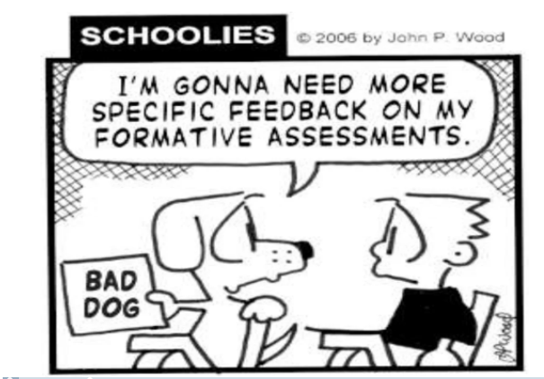

Slide 9
Summative
Summative assessment on the other hand focuses on assessing learning at the end of instructional unit and comparing and benchmarking it with predefined standards and competencies.
Summative assessment is used more from an evaluative purpose rather than a diagnostic one which is the domain of formative assessment.
Summative assessment is used to determine effectiveness of a program, students’ achievements etc. after learning has been completed.
For that purpose, summative assessment places more emphasis on accountability with the assignment of a grade.

Slide 10

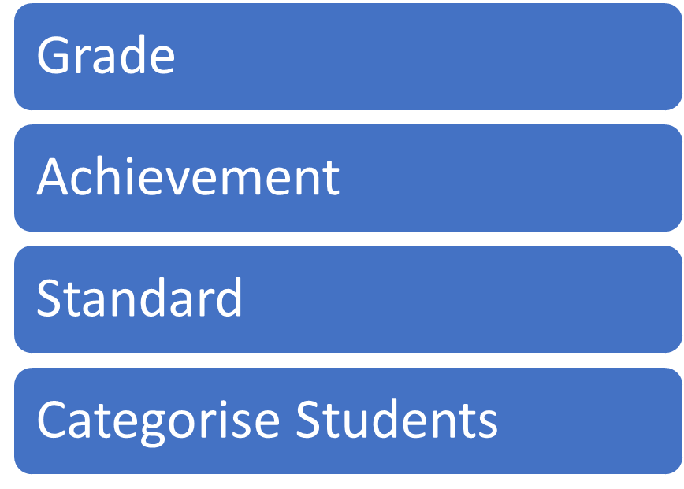
ASSESSMENT CATEGORIES
FORMATIVE
SUMMATIVE
SUMMATIVE (Assessment of Learning)
Feedback
Ongoing
Identify difficulties
FORMATIVE (Assessment for Learning)
Feedback
Ongoing
Identify Difficulties

Slide 11


FORMATIVE AND SUMMATIVE-THE DIFFERENCE
When the chef tastes the soup, it’s formative
When the customer tastes the soup, it’s a summative

Slide 12
Why is Assessment Important?
Students will have a clearer vision of what is expected of them and generally will be more positive about their course experiences.
Can help identify problems within a particular curriculum. It can establish a need for increasing the emphasis of particular skills areas within the curriculum. It can tell you whether or not your students are learning what you want them to learn.
Instructional methodology and practice – Outcomes assessment can help faculty evaluate teaching practices to address issues like the increasing numbers and diversity of students; stakeholder emphasis on value-added education; legislative desire for a productive, competitive workforce.
Assessment results can be used to improve retention and recruitment as well as service and support areas on campus.

Slide 13


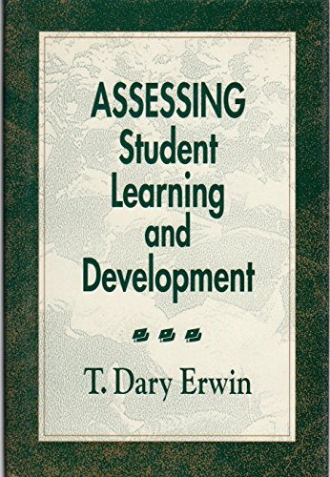


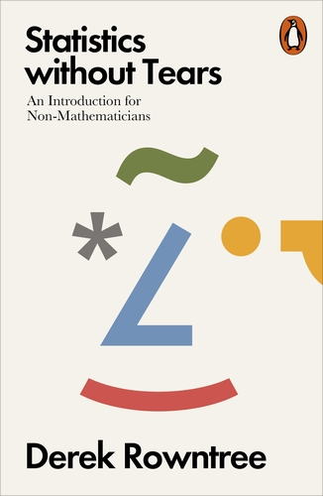
“…process of defining, selecting, designing, collecting, analyzing, interpreting and using information to increase students learning and development” -Dary Erwin
“…is about getting to know our students and the quality of their learning”-Derek Rowntree

Slide 14
Types of Assessment

Slide 15

Issues in Assessment
Number of learners
Timely delivery of results
Feedback to learners
Teacher workload
Student workload
Reliability and validity
Availability of technology

Slide 16

Types of Assessments
Objective
Subjective
Authentic

Slide 17
Objective-type of Assessments
Choices given to select one or more answers from many
multiple-choice, true false, matching, etc.
Notes:
These are selected response type of assessment. In this type of assessment, students are usually given choices to select one or more answers from many. Comprehension type assessments aim for students to understand remember and/or memorize concepts and ideas (Van den Broek et al., 2005). They are mostly meant for formative type assessment as they are quicker tools to gather information that can be used to monitor student learning and make necessary adjustments (Cornelius, 2013; Wormeli, 2007 ; Tomlinson, 1999). These include assessment such as multiple-choice, true false, matching ranging etc.
Quiz (short answer, multiple choice)
Short but frequent quizzes can help both the instructor and the student track their learning progress. A quiz can be just 10-15 questions long to provide sufficient information for feedback.
For multiple choice quizzes, automated grading can save instructors time and provide quick feedback for students.
For short answer or short constructed response items, instructors may want to provide additional commentary feedback through emails or through the use of a private communication platform in a Learning Management System.

Slide 18

Subjective-type of Assessments
Short Answers
Essays
Research Papers
Reflection Papers
Discussions
E-portfolios
Case Studies
Notes:
Instructors can use mechanism in Learning Management Systems to increase academic integrity (see Academic Integrity section of the module).
Plan and reserve computer labs well in advance if using human proctors.
These assessments focus not only on the correct answers of a given problem, but they emphasize the thought processes that lead to that answer (Frederick, 2002).
These are assessments for which students are expected to articulate more elaborate responses to questions related to skills and knowledge learned in the course.
These assessments allow students to formulate their responses using theoretical and practical knowledge.
Examples of these assessments include:
short answers
essays
minute papers
research papers
reflection papers etc.
Cumulative assessments such as eportfolios can also promote students reflective skills in addition to helping them connect different learning events and opportunities that happen during a course.
Discussion boards are well-suited for promoting collaboration and interaction among online learners.
According to Shuey, (2002), these can be used to assess skills such as:
reasoning
collaboration
negotiation
argumentation
debating
Teamwork (clark, Sampson, Weinberger, & Erkens, 2007)
This method of assessment promotes active learning and also allows student to support each other in the form of a learning community and therefore assists developing multiple perspectives (Gikandi et al., 2011; Mackey & Evans, 2014)
Case studies can be used for individual or group assessment
Asynchronous communication environment (discussion/blogs instead of chat) is actually more appropriate for problem based approaches because students have more time to reflect and collaborate with each other.
Teams of 5-6 are recommended.
Here is an example of using case study for online assessment: Each team member can be responsible for contributing responses for one or more cases by posting their reports and supporting materials. Other team members then respond with questions to the original posts. Based on question and critiques from team members, students can revise individual reports. Instructor can follow up by asking students to develop a case from their real world experience. Students can use a variety of methods such as simulation/games, videos, slide shows, photos, staged dialogue, and narration over text and images.

Slide 19
Types of assessments
Essay type
Long answer (1000-1200 words
Short answer (150-500 words)
Objective type
Single/Multiple choice
Matching
Fill-in-the-blanks
True-False
Home assignments (open book)
Timed test (Speed test)
Group tests
Online tests (proctorial)
Tests within LMS
Laboratory (skills-based) tests

Slide 20

Authentic Type of Assessments
Project Based
Problem Based Learning
Virtual Realities
Peer Assessment
Notes:
Normally with a presentation element
Project-based learning (PBL) organizes learning around a project and involves answering authentic, real-life challenging questions involving students in constructive investigation (Thomas, 2000).
These assessments include presentations and products. These types of products require manual grading based on rubrics.
Examples of such skills include:
the ones requiring students to integrate different skills to create a product (a business plan, or lesson plan)
The ones related to oral communication (i.e interacting with audience, keeping eye contact, tone of voice etc…) which cannot be assessed from written work since they require live or recorded demonstration.
Projects based assessment provides an opportunity for students to work in groups or individually, and the interaction among group members can be analyzed as part of this assessment. Examples of project-based assessment in this sample course included, using livebinder to compile a list of 20 websites that they can use in their future classroom, using smore to create a flyer on computer security for the students and parents etc.
Presentations
Presentations can be in the form of informational web pages such as blogs, web-based student-generated quizzes, video/audio, or slide shows.

Slide 21

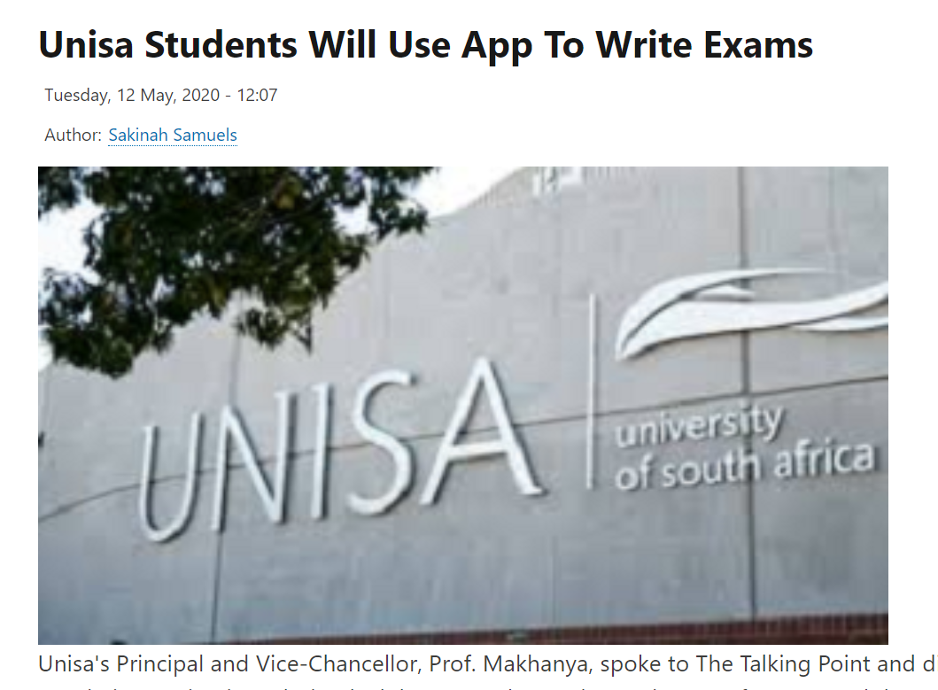
New ways of student assessment
Alternative assessment
Open book examination
Oral assessment
Online proctored examination
Mobile apps
Source: https://www.careersportal.co.za/news/unisa-students-will-use-app-to-write-exams
Notes:
Open book – India
Oral assessment in Business School, Griffith University, Australia
Mobile Apps in South Africa
Online proctoring software in many places.
A study in the North America revealed 64% of teachers changed assignments and exam during the COVID-19, whereas 46% also dropped some assignment or exam. (Johnson etal, 2021)

Slide 22
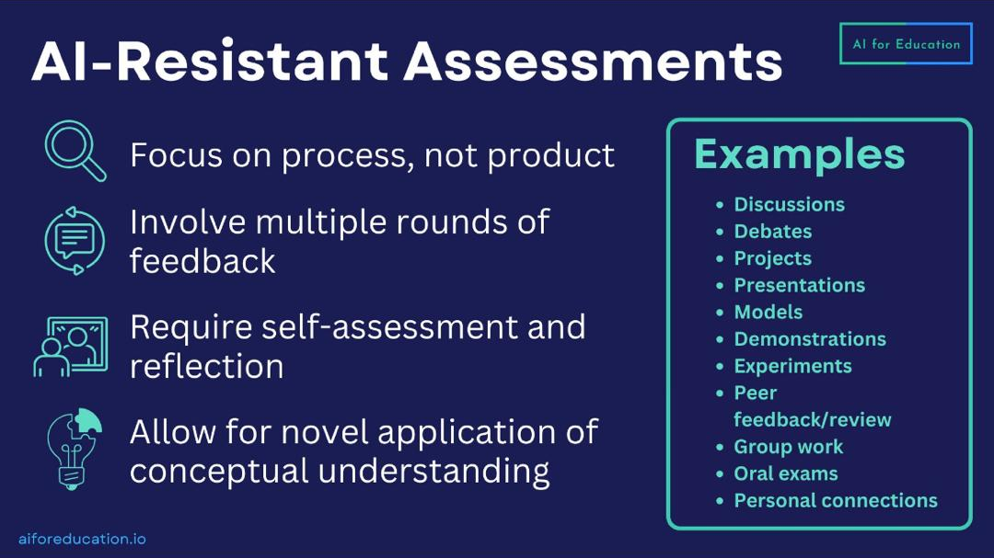

Slide 23
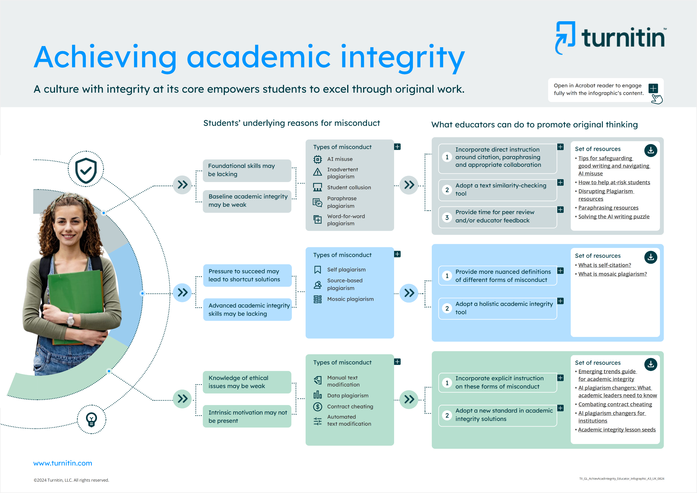

Slide 24
Authentic Assessment

Slide 25
Authentic Assessment
is realistic.
requires judgment and innovation.
asks the student to “do”.
replicates or simulates the contexts in which adults are “tested” in the workplace or in civic or personal life.
assesses the student’s ability to efficiently and effectively use a repertoire of knowledge and skills to negotiate a complex task.
allows appropriate opportunities to rehearse, practice, consult resources, and get feedback on and refine performances and products.
Source: Wiggins, Grant. (1998). Ensuring authentic performance. Chapter 2 in Educative Assessment: Designing Assessments to Inform and Improve Student Performance. San Francisco: Jossey-Bass, pp. 21 – 42.

Slide 26
Designing Authentic Assessment
What is the outcome behavior to be assessed? Does it require practical/lab?
Can it be automated? Do you have the technologies? Do students have access?
Do you have continuous assessment? What is the weight of continuous assessment vs terminal test? Can the weight be changed to focus on ‘assessment for learning’?
Do you use LMS for course delivery? If yes, use the internal features for continuous assessment.
Consider online authentic assessment as alternative to terminal test.
Develop authentic tests.

Slide 27
Design Learning Outcomes
What should learners know and be able to do at the end of the course?
How will we know that learners know and are able to do this?
What content/activities should be provided?
‘Making Digital Assessment Count: Designing for Engagement, Integrity, Authenticity’. COL Knowledge Series, 2022

Slide 28
Design for Academic Integrity
More flexibility—different kinds of assessments
Regular formative assessment
Applied learning specific to the course
Designing localized assessments
Collaborative activities
Problem-solving projects
‘Making Digital Assessment Count: Designing for Engagement, Integrity, Authenticity’. COL Knowledge Series, 2022

Slide 29
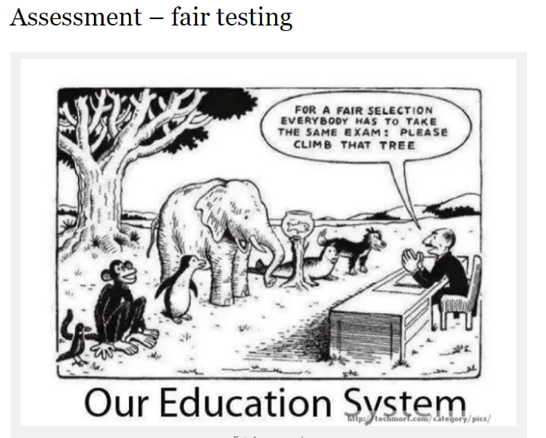

Slide 30
Alternative Assessments
Online
Offline
Participation in discussion forum
Peer assessment
Synchronous online seminar presentations
Online projects (e.g., coding)
E-Portfolio
Reflective Journal
Blogs contribution
Wiki Collaboration
Audio and video assignments
Online objective type questions
Project-based (as term-end exam)
Term Paper (as term-end exam)
Portfolio
Evidence-based approaches (Recognition of Prior Learning)

Slide 31
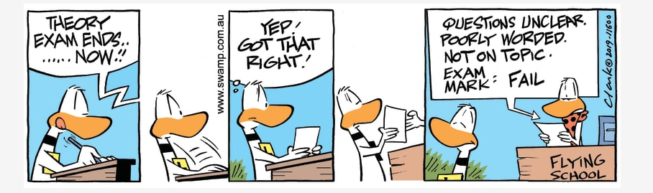

Slide 32

Micro-credentials
Industry-Academic Partnership
Online Learning
Proctored Test
Credits for formal learning and/or Employment
Short duration
Modular approach
Skills based
Community learning
Self-paced
Mentoring support
Verifiable credential
Project-based
Job-ready
Reduced cost
Blended with F2F for formal degree

Slide 33
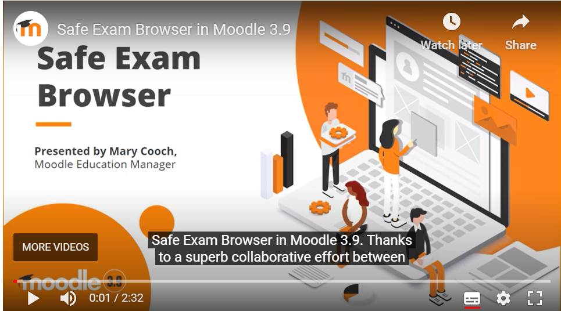
Technologies for Assessment
Online Exam: TCExam (https://tcexam.org/)
LMS for Exam: e-Exam (http://www.transformingexams.com/guides.html)
Lockdown Browser: Safe Exam Browser (https://safeexambrowser.org)

Slide 34

Some Resources
Authentic Learning http://authenticlearning.info/Home.html
Authentic activities and online learning https://ro.ecu.edu.au/cgi/viewcontent.cgi?article=4899&context=ecuworks
Designing authentic activities in web-based courses https://link.springer.com/article/10.1007/BF02960280

Slide 35

Role of AI?
Test Items
Quizzes
AI supports automated grading
Image Source: https://securitymea.com/2023/02/24/new-malware-stealing-social-media-credentials-under-chatgpt-app-disguise/
Notes:
An AI-based service that uses Natural Language Processing technology such as ChatGPT can reduce teacher’s time spent on mundane tasks. Can help the teacher with improved monitoring can serve as an assistant to the teacher in generating lesson plans or to create tests; can create images for teaching from text commands of the teacher. Using new AI services, micro-courses can be created using simple textual description.
A Large Language Model (LLM)
Trained on massive quantities of data
To generate human-like text
G(enerative) P(re-trained) T(ransformer)
Transformer is an advanced AI technology developed in 2017- an example is language translation
Much wider capabilities in May 2023 through plugins

Slide 36
What is Authentic Assessment? (a recap…)
Authentic assessments involve the application of knowledge and skills in real-world situations, scenarios, or problems. Authentic assessments create a student-centered learning experience by providing students opportunities to problem-solve, inquire, and create new knowledge and meaning.
application of knowledge and skills
real-world situations, scenarios, or problems
student-centered learning

Slide 37
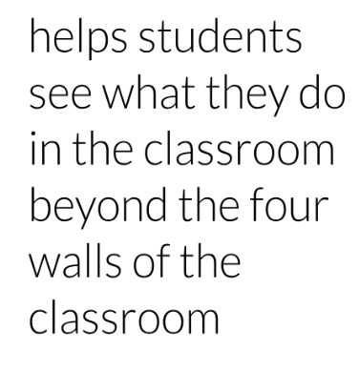
Authentic Assessment

Slide 38
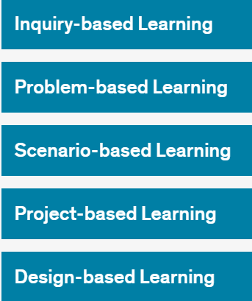
Types of Authentic Assessment

Slide 39
Type of Tasks
Constructed Response
Product
Performance

Slide 40
Example of some authentic outputs
Information leaflet
Consultancy report
Business plan
Marketing campaign with a rationale
An exhibition/event
Blog
Reflective Commentary
https://www.reading.ac.uk/cqsd/-/media/project/functions/cqsd/documents/ade/tandl-resources/prp-authentic-assessment.pdf

Slide 41
Learning
Outcome(s)
Authentic
Assessment

Slide 42
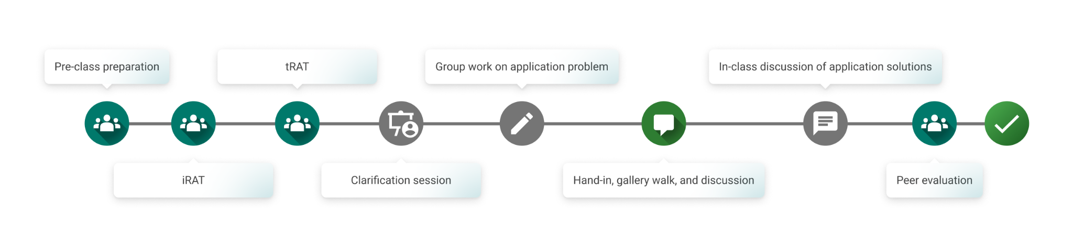
Student Journey in Authentic Assessment
https://feedbackfruits.com/learning-journeys/team-based-learning

Slide 43
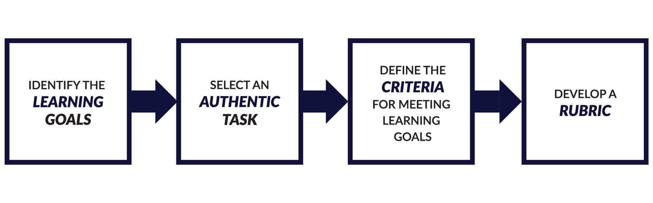
Mueller Model (Mueller, 2018):

Slide 44
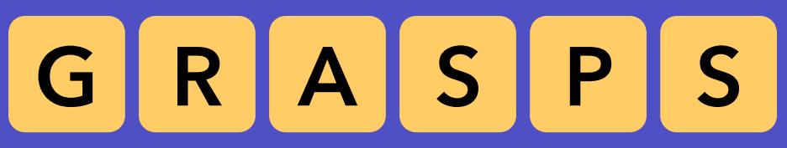
Grasps Model (Wiggins & McTighe, 2004):

Slide 45
Developing assessment via GRASPS model
To develop an authentic assessment, one useful framework is the GRASPS model developed by Grant Wiggins and Jay McTighe.
The acronym GRASPS stands for:
G—a realistic goal
R—the role of the student
A—the audience
S—the real-world situation
P—the product or performance the student will demonstrate
S—the criteria for judging success

Slide 46
G - Goal
Goal | Guidance | Guiding Questions | Example
The goal defines the conceptual understanding and the problem or outcome of the project | Write as one statement Sound like a strong statement of inquiry Driven by the conceptual understanding of the unit/topic | What is the authentic goal related to the discipline? What makes this goal worthwhile for the students to investigate? What prior knowledge do the students have that will help them to achieve the goal? How will students understand the importance of the goal? | Develop a mobile application for appointment booking in a small clinic.
Adapted from https://www.aidan-hammond.net/new-blog/tag/GRASPS

Slide 47
R - Role
Role | Guidance | Guiding Questions | Example
Define the role of the students and the perspective from which they approach the task | Identify the authentic roles and help students understand the scope of the role Roles should frame the perspective from which students engage with the inquiry | What are the authentic roles that are related to the goal or discipline? How will students understand the scope and expectations of the role? What skills and knowledge will students need to be successful in this role? | You are a software developer working with a health service provider.
Adapted from https://www.aidan-hammond.net/new-blog/tag/GRASPS

Slide 48
A - Audience
Audience | Guidance | Guiding Questions | Example
Define the relationship between the audience and the students. How will the two interact? | Define the authentic audience Avoid being too broad Consider the relationship between the role and the audience (not the teacher) | What is the relationship between the audience and the role? What are the characteristics of the audience, and how might these influence the skills and knowledge needed by students to be successful? | Clinic staff and patients.
Adapted from https://www.aidan-hammond.net/new-blog/tag/GRASPS

Slide 49
S - Situation
Situation | Guidance | Guiding Questions
Describe the context for the inquiry/problem. Should provide enough detail and scaffolding to allow students to engage with the concepts | Use the topic concepts to define the situation Situation should be engaging and educational Allow an element of choice in how they approach the task | How will the students understand the significance and value of the situation? How is the situation connected to an authentic, real-word experience or situation? What prior skills and knowledge of the concepts do the students have?
The clinic struggles with manual booking and wants a simple digital solution.
Adapted from https://www.aidan-hammond.net/new-blog/tag/GRASPS

Slide 50
P - Product
Product | Guidance | Guiding Questions | Example
Define what will be produced in relation to the task | It should be authentically related to the Goal, Role, Audience and Situation Allow differentiation in how they approach the task | How will students show their conceptual understandings through the product? How can the task be structured to allow for differentiation and student choice in the final product? How will the students understand the content and quality expectations for the product? What knowledge and skills needed by the students to be successful? | A working prototype of the app, user interface design, and a presentation of features.
Adapted from https://www.aidan-hammond.net/new-blog/tag/GRASPS

Slide 51
S - Standard
Standard | Guidance | Guiding Questions | Example
Identify the standards that will be used to evaluate the success of the performance/product | Only use strands that can effectively assess the product Written in clear, student-appropriate language | Wow will the standards be communicated to students? How will students manage their progress on the task? Are the expectations and task-specific clarifications clear, reasonable and achievable? How will students use the standards to monitor and self-evaluate the success? | Usability, security, and efficiency.
Adapted from https://www.aidan-hammond.net/new-blog/tag/GRASPS

Slide 52
Example of Authentic Assessment
Construction & Carpentry
Goal: Design and build a functional wooden table for a community center.
Role: Apprentice carpenter in a construction workshop.
Audience: Community leaders and potential clients.
Situation: A local center needs durable, cost-effective furniture. You must measure, design, and construct a table using sustainable materials.
Product/Performance: A physical table and an explanation of material choices.
Standards: Durability, sustainability, and safety standards.

Slide 53
Example of non-GRASPS model
If x kilograms of flour are needed for 5 loaves of bread, how much flour is needed for 100 loaves?
Notes:
One important element of authentic assessment is scaffolding
Scaffolding is “an instructional strategy to provide students with a framework that guides and supports their learning”
Strong scaffolding is essential for authentic assessments, as learners may still be developing the necessary skills for completing the tasks
The goal of scaffolding is not to make learners dependent upon this guidance, but to help them build their own abilities and work independently
Tailor scaffolding to what the learners most need and gradually reduce the supports as they progress through the assessment

Slide 54
Scaffolding strategies for authentic assessment
Break a complex authentic task into smaller subtasks
Provide examples of what you would like to see
Connect learners’ current knowledge and skills with prior knowledge
Help learners to get organised before approaching a task
Create spaces for peer-to-peer learning and collaboration
Ask students to self-reflect
Notes:
One important element of authentic assessment is scaffolding
Scaffolding is “an instructional strategy to provide students with a framework that guides and supports their learning”
Strong scaffolding is essential for authentic assessments, as learners may still be developing the necessary skills for completing the tasks
The goal of scaffolding is not to make learners dependent upon this guidance, but to help them build their own abilities and work independently
Tailor scaffolding to what the learners most need and gradually reduce the supports as they progress through the assessment

Slide 55
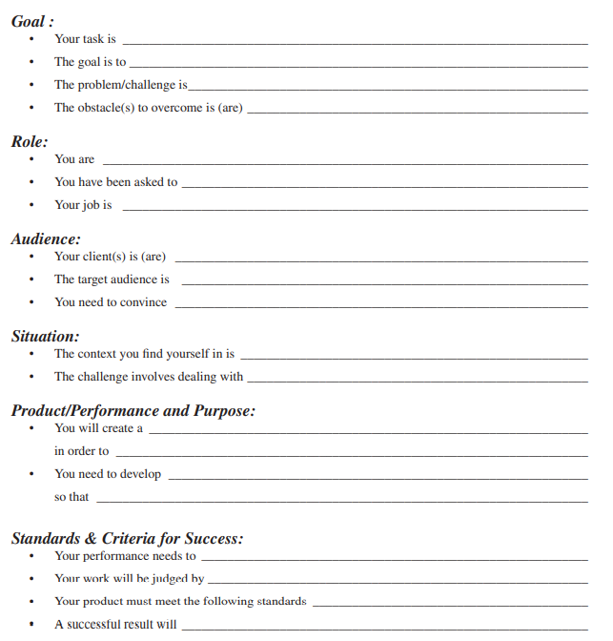
GRASPS Design Sheet
Source:
McTighe, J. & Wiggins, G (2006) Understanding by design: Professional development handbook. Heatherton, Victoria: Hawker Brownlow Education.

Slide 56
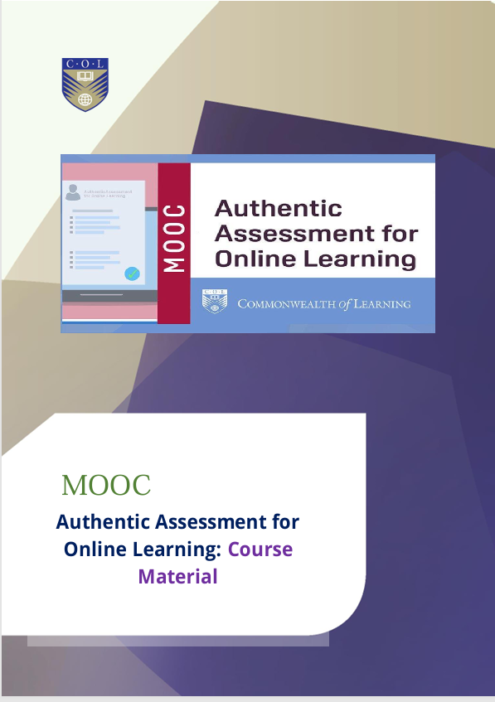


Slide 57
Thank you

