Slide 1
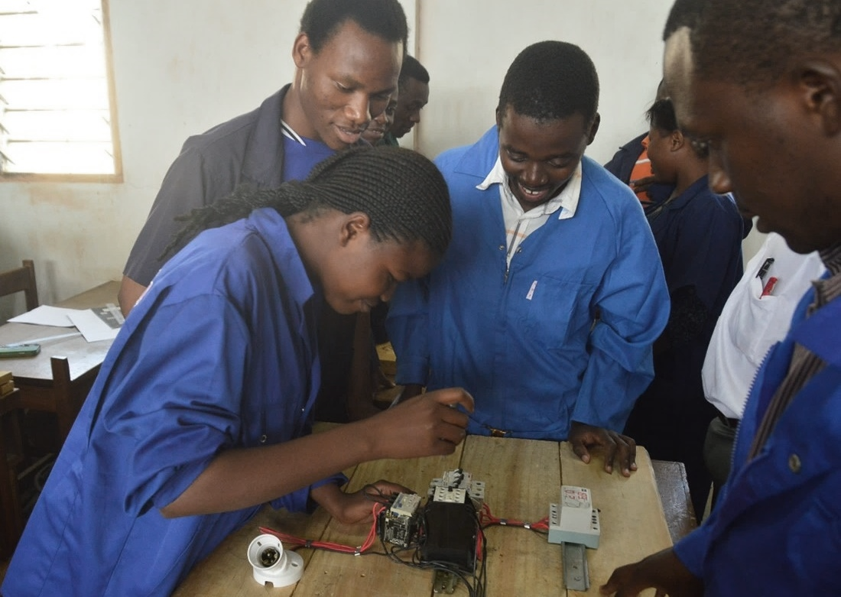
Open Educational Resources (OER): how can we benefit?
Professor Asha Kanwar
With inputs from
Prof Rory McGreal, Athabasca University
Dr Sanjaya Mishra, Commonwealth of Learning
26 March 2025

Slide 2
Outline
Brief history of OER
Five key challenges
Using OER
OER for course development

Slide 3
Brief history of OER

Slide 4
What are OER?
OER are teaching, learning and research materials in any medium – digital or otherwise – that reside in the public domain or have been released under an open license that permits no-cost access, use, adaptation and redistribution by others with no or limited restrictions.
UNESCO, 2017. Ljubljana OER Action Plan 2017, Paris: UNESCO, Pg 1.

Slide 5
Where it all began…
Notes:
Different needs and priorities

Slide 6
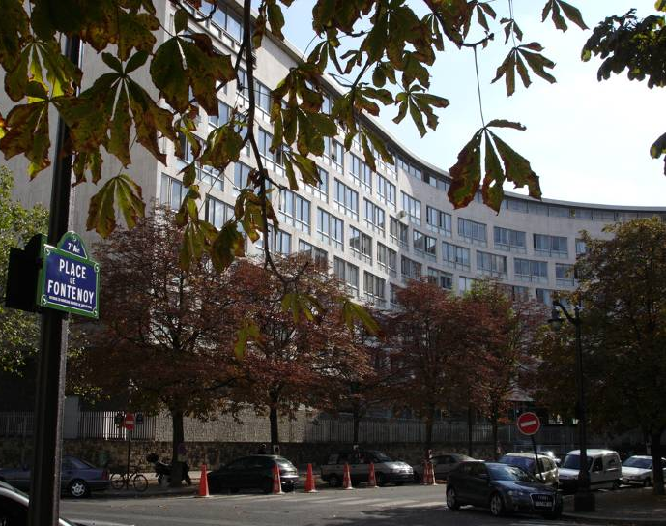
UNESCO HQ Paris
2002 Forum on the Impact of Open CourseWare for Higher Education in Developing Countries
Notes:
UNESCO convened the Forum on Impact of Open Courseware for Higher Education in Developing Countries in 2002.
A working definition of OER emerged…

Slide 7
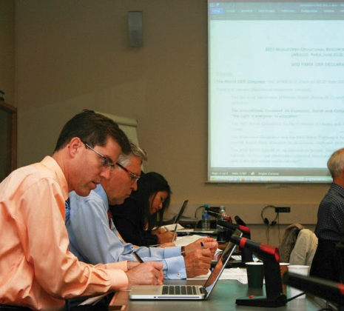
Paris Declaration 2012
Foster awareness and use of OER
Encourage the development and adaptation of OER in a variety of languages and cultural contexts
Encourage the open licensing of educational materials produced with public funds.

Slide 8
OER for Inclusive and Equitable Quality Education From Commitment to Action
2nd World OER Congress| 18-20 September, 2017 | Ljubljana, Slovenia
Notes:
The Year of Open 15 years ago the term Open Educational Resources was coined
Budapest Open Access Initiative was launched
Creative Commons was started
10 years ago Cape Town Declaration was written
5 years ago OER Paris Declaration was adopted
2nd World OER Congress held

Slide 9
Dubai Declaration
Using AI to developing new OER, curating existing ones, translating them into multiple languages, and indexing them effectively.
Ensuring the provenance, integrity, and lawful use of OER through technologies like cryptographic signing and blockchain.
Supporting professional development for educators and content creators on copyright and open licensing,
Promoting digital literacy

Slide 10
Advance over previous Declarations
Leverages AI to create new OER, enhance translation capabilities, and adapt content for diverse learners.
Utilize blockchain to provide a secure method for tracking and verifying the origin and authenticity of educational resources.
Emphasize professional development for educators and content creators on copyright and open licensing, and promoting digital literacy for responsible use of AI and blockchain
Advocates for policy that protects authorship and ensures open licensing in AI applications, so that AI-generated content is openly licensed and properly attributed.
Supports the development of technologies like cryptographic signing and machine learning to improve attribution and discoverability of OER.

Slide 11
Five key challenges

Slide 12
Key Challenges
Developing supportive policy environments
Ensuring inclusive and equitable access to quality OER
Building the capacity of users to find, re-use, create and share OER
Language & cultural issues
Developing sustainability models
Source: Ljubljana OER Action Plan 2017

Slide 13
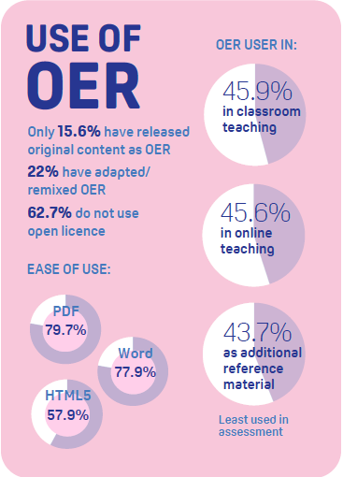
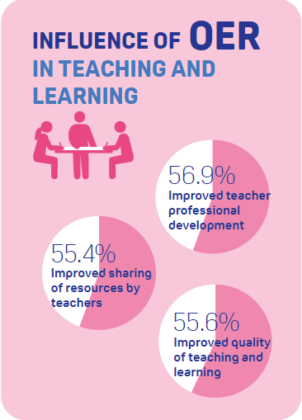
1. Policy OER in the Commonwealth
Source: http://oasis.col.org/handle/11599/4009

Slide 14
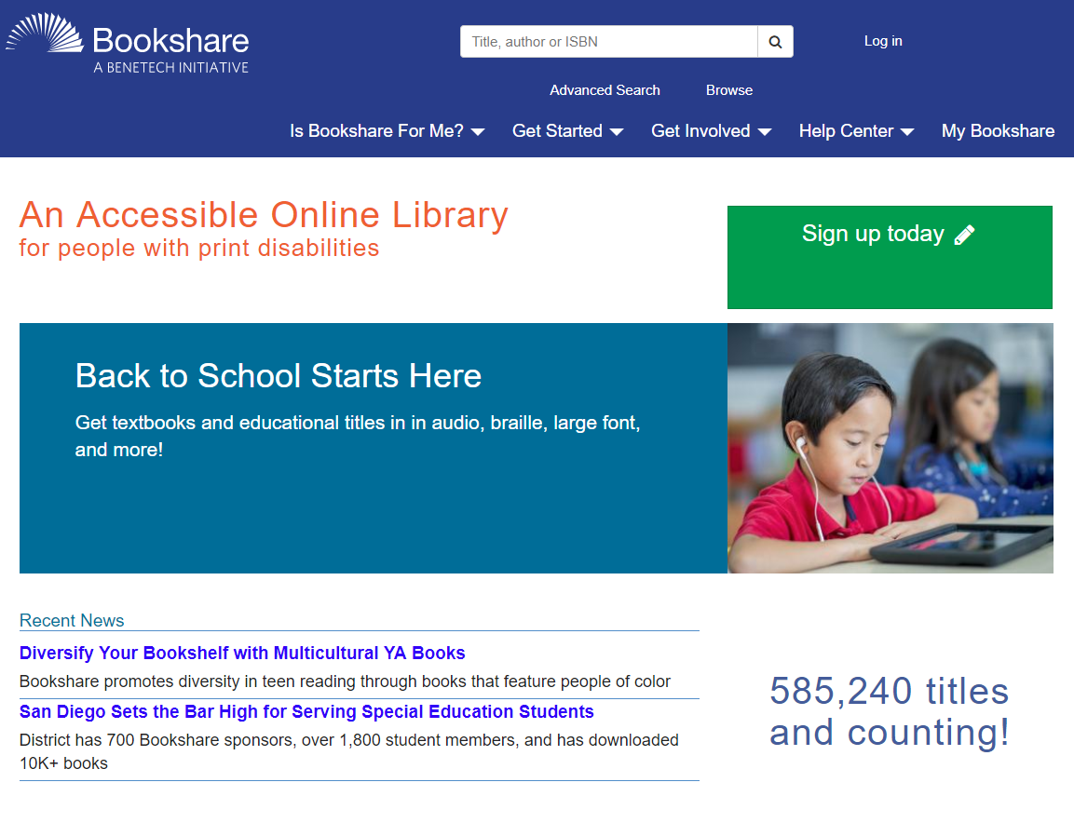
2. Inclusive and Equitable Access
ebooks (including exceptions in copyright for people with disability)
Open Access
FOSS
Notes:
https://www.bookshare.org/cms/

Slide 15
3. Capacity Building
Teachers: difficult to locate, adapt, and re-purpose OER material relevant to their work.
Learners: OER should be more open and multi-modal.
Technical support: lack of standard practices in the packaging and re-use of OER.
Management: concerns regarding intellectual property; copyright issues and competition
Source: OER Survey, Asia, 2011 (WOU, IDRC)

Slide 16
4. Language & Culture: Translation
COL ID template
translated and adapted by Open University of China
COL materials in Ukrainian
CORE

Slide 17
5. Sustainability Models
FUNDING
Endowment
BUSINESS
Cross Subsidy
Membership
Collaboration
Institutional/governmental
Ad-supported
Freemium
Gift economy
Notes:
Endowment Model (eg. Funded by Hewlett)
Membership Model (eg. OER Africa; AVU)
Donations Model
Institutional Model
Governmental Model
Collaboration Model (eg. OERu)
Cross Subsidy Model (eg. Buy one get one free)
Ad-supported Model (eg. Google, Free-to-air radio and TV)
Freemium Model (eg. Basic model is free, premium is priced)
Gift economy Model (eg. Wikipedia; labour exchange based on shared free time)
Stephen Downes, 2006

Slide 18
Institutional/Governmental models
In USA, the Z-degree programmes save about USD2,500 per student
BC Campus in Canada has saved over 9 million CAD in 40 participating institutions

Slide 19
Using OER

Slide 20
Where can we find OER?
Search Engines: Google, Bing, Creative Commons Search
Repositories: MIT OCW, OpenLearn
Directories: DOER, OER Commons
Photos: www.flickr.com
Videos: www.youtube.com

Slide 21
How do we acknowledge?
Title
Author
Source
Link

Slide 22
How do we share our OER?
Your institutional repository
Share courses at
https://zenodo.org/
Use social networks
www.youtube.com

Slide 23
What is Open?
5Rs
Reuse (copy verbatim)
Revise (adapt and edit)
Remix (combine with other materials)
Redistribute (share with others)
Retain (make, own and control copies)
Its about open license used to share educational material
No permission required as long as the open license is respected

Slide 24
Copyright
Prohibits unauthorized use, distribution, performance, adaptation, sell, etc.
Requires permission of the Copyright holder for creating any derivative works
Fair use or fair dealing is though permitted
Examples of fair use include commentary, search engines, criticism, news reporting, research, teaching, library archiving and scholarship.

Slide 25
Copyright
Exclusive rights given by law to the original creator/author
To get credit
To copy
To distribute
To license
To sell/make economic transaction
To perform

Slide 26
Open Licenses
They allow anyone worldwide to use a copyrighted work without necessarily having to pay a fee or royalty or ask permission as long as they adhere to the conditions specified in the licence.
Only if a person desires to use a work in a way other than that specified in the licence that permission needs to be sought from the copyright holder.
Presently, the most common and popular open licence are Creative Commons licences.

Slide 27
Creative Commons (CC)

Slide 28
Types of CC Licenses and Conditions
Creative Commons
Concepts
CC-BY
CC-BY-SA
CC-BY-NC
CC-BY-NC-SA
CC-BY-ND
CC-BY-NC-ND
Attribution
Share Alike
Non-Commercial
Non-Derivative

Slide 29
Types of CC Licenses and Conditions
CONCEPTS
CC-BY
CC-BY-SA
CC-BY-NC
CC-BY-NC-SA
CC-BY-ND
CC-BY-NC-ND
ATTRIBUTION
SHARE ALIKE
NON-COMMERCIAL
NON-DERIVATIVE

Slide 30
Attribution (CC BY)
This licence lets others distribute, remix, tweak, and build upon your work, even commercially, as long as they credit you for the original creation.
This is the most accommodating of licences offered.
It is recommended for maximum dissemination and use of licensed materials.

Slide 31
Attribution-ShareAlike (CC BY-SA)
This licence lets others remix, tweak, and build upon your work even for commercial purposes, as long as they credit you and license their new creations under the identical terms.
Often compared to “copyleft” free and open source software licences.
All new works based on yours will carry the same licence, so any derivatives will also allow commercial use. This is the licence used by Wikipedia.

Slide 32
Attribution-No Derivatives (CC BY-ND)
This licence allows for redistribution, commercial and non-commercial, as long as it is passed along unchanged and in whole, with credit to you.

Slide 33
Attribution-Non Commercial (CC BY-NC)
This licence lets others remix, tweak, and build upon your work non-commercially, and although their new works must also acknowledge you and be non-commercial, they don’t have to license their derivative works on the same terms.

Slide 34
Attribution-Non Commercial-No Derivatives (CC BY-NC-ND)
This licence is the most restrictive, only allowing others to download your works and share them with others as long as they credit you, but they can’t change them in any way or use them commercially.

Slide 35
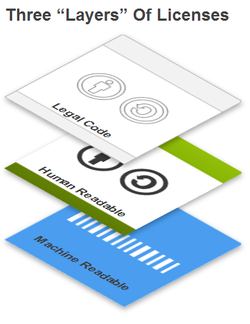
Why Use Creative Commons licenses?
Legal Code: expansive legal languages tested in several cases
Commons Code: Simple icon-based approach to explain what you can do want you can’t
Digital Code: Enables search engines to search and locate through CC Rights Expression Language

Slide 36
Creative Commons Public Domain Tools
CC’s public domain tools enable authors and copyright owners who want to dedicate their works to the worldwide public domain to do so.
The CC-0 tool (“No Rights Reserved”) allows licensors to waive all rights and place a work in the public domain.
The Public Domain mark identifies a work that is free of known copyright restrictions. It is not recommended for works that are restricted by copyright laws in one or more jurisdictions.

Slide 37
CC Licence Chooser
https://creativecommons.org/choose/
Allow adaptations of your work to be shared?
1
Yes
No
As long as others share alike
Allow commercial uses of your work?
2
Yes
No
Select Licence
3
Copy the Code to use
4
Choose License Feature

Slide 38
OER for Course Development

Slide 40
WWW Course Design
Check what is available:
OER Repositories
Websites,
Videos
Podcasts
Print

Slide 41
WWW Course Design
If appropriate material is available, then use it
Adapt your curriculum to include cool content.

Slide 42
WWW Course Design
Use a variety of learning resources, techniques & technologies
Don’t think there is one right way
Image: Hassonss

Slide 43
WWW Course Design
Take ideas from others
Be sure to credit!
There’s no copyright on ideas
Image: P.S. Bartlett

Slide 44
WWW Course Design
No one works alone
Organize course teams
Subject matter experts
Instructional designers
Technical supports
Image: RingCentralt

Slide 45
WWW Course Design
Create subject trails
Compile lists of content-related LINKS
Image: Searcharoot

Slide 46
Linking is FREE Use it!
You can LINK to licence-restricted content

Slide 47
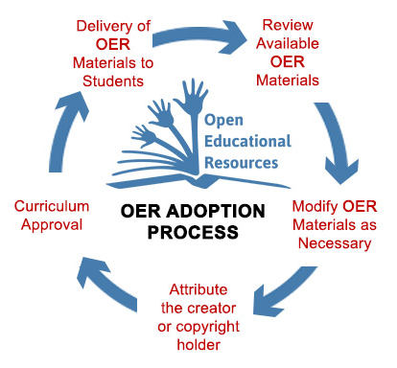
Image: NW Vista College

Slide 48
Imafe: M. Paskevicius

Slide 49
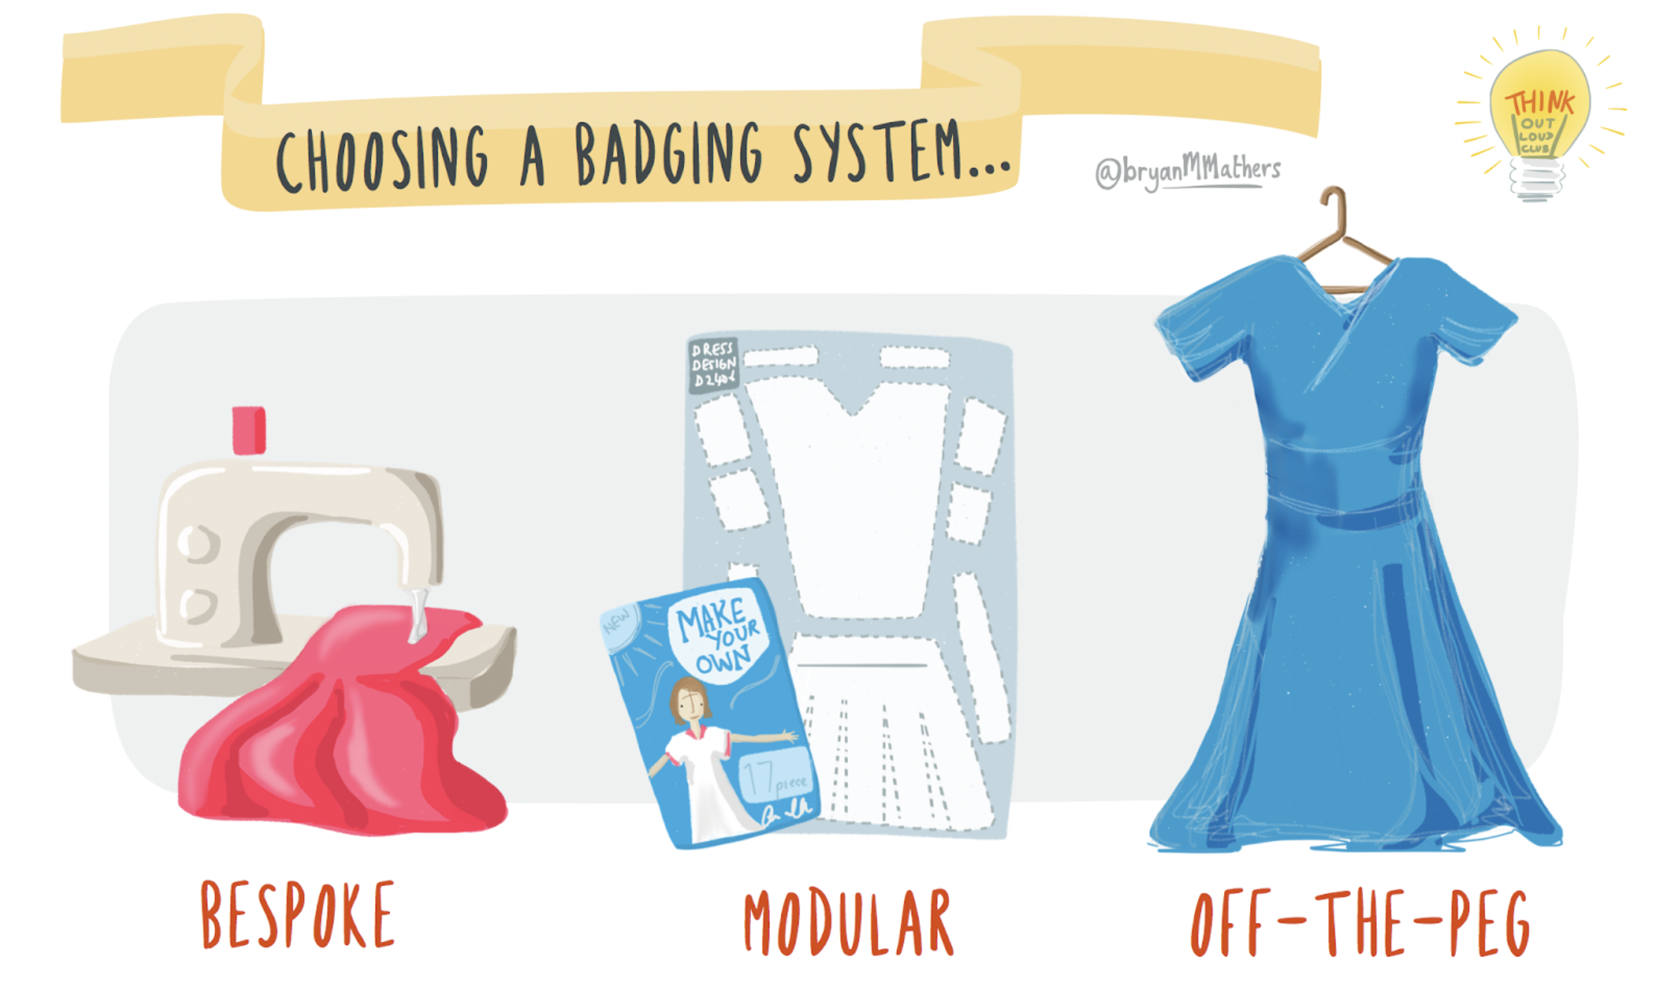
Approaches to OER Implementation
Create
Assemble
Full Course
Image adapted from BryanMMathers

Slide 50
Digital divide
Internet usage(2024)
Globally: 68% | SSA: 38 %
Mobile Cellular Subscriptions(2024)
Globally: 112% | SSA: 66%
Men: 70% | Women: 65%
Women are 7% less likely to own a mobile phone than men.
Sources:
International Telecommunication Union (ITU) Statistics: https://www.itu.int/en/ITU-D/Statistics/Pages/stat/default.aspx
Notes:
The digital divide continues to be a significant challenge in Africa.
Many schools and educators lack the resources and training necessary to utilise technology effectively.
Generic data
. Internet usage:
In 2021, only 28.2% of individuals in Africa used the internet, compared to the global average of 53.6%. Source: International Telecommunication Union (ITU) - https://www.itu.int/en/ITU-D/Statistics/Pages/stat/default.aspx
b. Mobile broadband subscriptions:
In 2020, there were 82 mobile broadband subscriptions per 100 inhabitants in Africa, compared to the global average of 111. Source: International Telecommunication Union (ITU) - https://www.itu.int/en/ITU-D/Statistics/Pages/stat/default.aspx
c. Access to electricity:
In 2019, only 48% of the population in Sub-Saharan Africa had access to electricity. Source: World Bank - https://data.worldbank.org/indicator/EG.ELC.ACCS.ZS?locations=ZG
Even where access to mobile devices among adults has reached 100% in some African countries (e.g., South Africa, Namibia and Zimbabwe), although a rural-urban divide persists in most, and women and girls often have less access than men
Laurillard D, Kennedy E, Wang T. How could digital learning at scale address the issue of equity in education? (Learning at Scale for the Global South). Foundation for Information Technology Education and Development; 2018. http://dl4d.or g/wp-content/uploads/2019/03/Learning-at-Scale-for-the-Global-South-Main- Paper.pdf.
Low level of absorption in the world of work
450 million disconnected from the opportunities offered by the digital economy

Slide 51
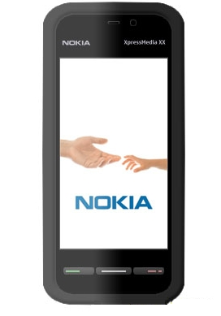
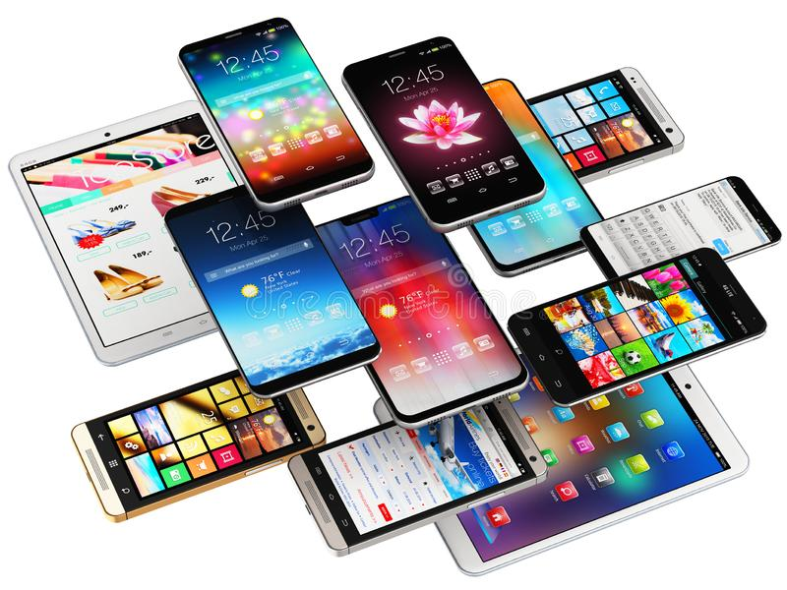
Design for Mobile FIRST
More time spent on Internet with Mobile than with desktops
Notes:
http://t1.gstatic.com/images?q=tbn:ANd9GcQDrZ2_qERetFBATyxwrFRdzLppa0A4HTg680pauoHxyM3FR4Jm
51

Slide 52
Issues in QA for OER
Who is responsible for the quality of repurposed content?
How do institutions ensure the integrity of content?
How are copyright issues addressed?
Is the content easily accessible?

Slide 53
What are Micro-courses?
Short courses
Narrowly focused
Competency-based
Can they be laddered for credit?

Slide 54
Micro-credentials: skilling and reskilling
Industry-Academic Partnership
Online Learning
Proctored Test
Credits for formal learning and/or Employment
Short duration
Modular approach
Skills based
Community learning
Self-paced
Mentoring support
Verifiable credential
Project-based
Job-ready
Reduced cost
Blended with F2F for formal degree

Slide 55
Why do we need Micro-Credentials?
Demand for short flexible courses from learners
Need to fill skills gaps by upskilling and reskilling the workforce
Need for verified skills based credentials from industry/employers.
‘skills, rather than occupations or qualifications, form the job currency of the future’ (Deloitte, 2019)

Slide 56
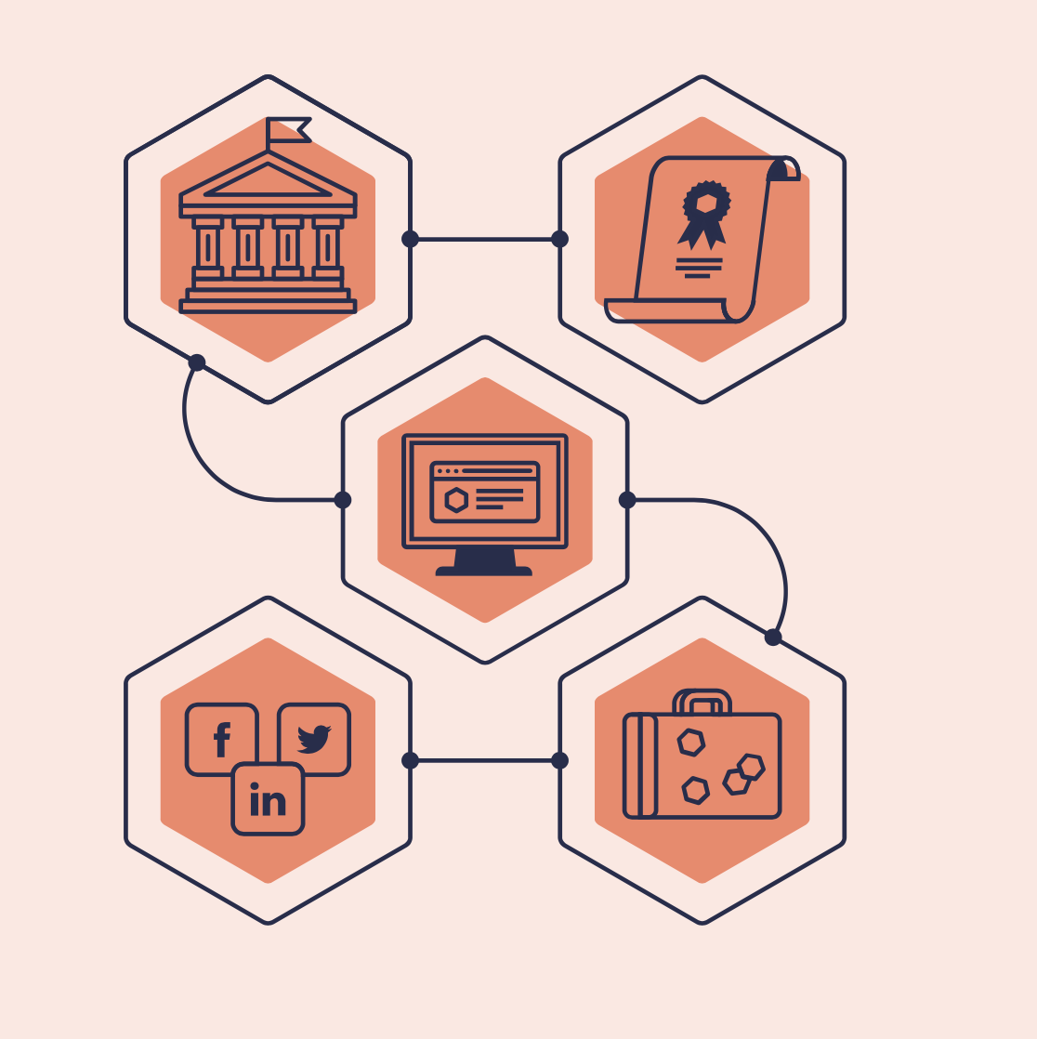
What kinds of credentials?
Badges
Certificates
Micro-credentials
Nanodegree
Macro-credentials
Image: Badgr.com

Slide 57
Micro-credentials are for CREDIT if not They are not Credentials
Image: Illinois Worknet

Slide 58
Image:Srimax

Slide 59
II. Technology

Slide 60
Swahili
Matokeo ya Kujifunza:
Kufikia mwisho wa kozi hii, wanafunzi wanapaswa kuwa na uwezo wa:
1. Kuelewa jukumu na majukumu ya wahandisi katika jamii.
2. Kutambua matawi muhimu ya uhandisi na matumizi yake.
3. Kutumia mbinu za kimsingi za kutatua matatizo ya uhandisi.
4. Kufanya kazi kwa ufanisi katika timu ili kuunda na kutekeleza suluhisho za uhandisi.
5. Kuwasilisha dhana za uhandisi kwa ufasaha katika maandishi na mazungumzo.
6. Kuonyesha kuzingatia maadili katika usanifu wa uhandisi na mazoezi.
AMHARIC
የማማልከት ውጤቶች:
1. ኮርሱን እንደጨረሱ ተማሪዎች እንደሚከተሉት ችሎታዎች ሊኖራቸው አለባቸው፤
2. በማህበረሰብ ውስጥ የመምህራን ኃላፊነትና ሥራ ምን እንደሆነ መረዳት።
3. ዋናዎችን የመምህራን ክፍሎችን እና ተግባራቸውን መለየት።
መሠረታዊ የመምህራን ችግር መፍታት ሥርዓቶችን ተግባራዊ እንዲያደርጉ።
4. በቡድን ስራ በቅናት እንዲሰሩ እና የመምህራን መፍትሄ እንዲሰጡ።
5. በጽሁፍ እና በቃል መግለጫ ሂደቶች ውስጥ የመምህራን ሀሳብን አጥርተው በግልፅ እንዲያስተላልፉ።
6. በንድፍ አስተዳደርና ንድፍ እንዴት እንደሚሰራ በሥነ ምግባር መረዳት።2.
By the end of this course, students should be able to:
Understand the role and responsibilities of engineers in society.
Identify key branches of engineering and their applications.
Apply basic engineering problem-solving techniques.
Work effectively in teams to develop and implement engineering solutions.
Communicate engineering concepts clearly and effectively in written and oral formats.
Demonstrate ethical considerations in engineering design and practice.
VIETNAMESE
Vào cuối khóa học này, sinh viên sẽ có thể: Hiểu được vai trò và trách nhiệm của kỹ sư trong xã hội. Nhận biết các ngành kỹ thuật chính và ứng dụng của chúng. Áp dụng các kỹ thuật giải quyết vấn đề cơ bản trong kỹ thuật. Làm việc hiệu quả trong nhóm để phát triển và triển khai các giải pháp kỹ thuật. Truyền đạt các khái niệm kỹ thuật một cách rõ ràng và hiệu quả bằng văn bản và lời nói. Thể hiện các cân nhắc đạo đức trong thiết kế và thực hành kỹ thuật
CHINESE
在本课程结束时，学生应能够： 理解工程师在社会中的角色和责任。 识别工程学的主要分支及其应用。 运用基本的工程问题解决技巧。 在团队中有效合作，开发和实施工程解决方案。 以书面和口头形式清晰有效地传达工程概念。 在工程设计和实践中展示伦理考量。

Slide 61
Towards Effective Learning
Learners become producers rather than consumers
Multi-media resources for a rich learning experience
Collaboration, sharing and interaction
Personalized and contextual learning

Slide 62
Resources
A Basic Guide to OER http://oasis.col.org/handle/11599/36
Understanding OER http://oasis.col.org/handle/11599/1013
Online Course on OER http://tell.colvee.org/

Slide 63
Thank you

